Slide 1
PACB MARKETING CONFERENCE 2022
How to Leverage Your Data to Compete
Rich Carlton, President
Notes:
Raise your hand if your bank prides itself in personal white glove service for your customers. Keep your hand up if your customers are demanding a digital experience. Keep your hand up if that demand was accelerated by the pandemic. Now keep your hand up if your bank is managing over $100B in assets.

Slide 2
Mid-Market Financial Institutions will not “out tech” large banks and fin-techs on their own.
However, with the right partners, Community Financial Institutions have an opportunity to thrive by re-defining the local experience by digitally transforming how they operate…
Notes:
Let’s face it – the midmarket will not out-tech the big banks. You thrive on personalized white glove service. Yet in an increasingly digital world, how do you shine? You shine by making your white glove service data driven. You use data analytics for targeted personalized interactions to deepen customer relationships. While big banks have departments of data scientists building solutions, the mid-market needs to partner for success. But you can win against the global giants by using data to re0define the local experience.

Slide 3
Challenges
Analytics Road Blocks
Data
Technology
People
Siloed data
Dirty data
Difficult to join
Data points you need that don’t exist
Challenge to share insights rapidly across the enterprise
Systems of record not analysis
Legacy data warehouse not set up for volume, variety & velocity of data
Lack of automation & integration
No capability for machine learning and AI
Time intensive
Lack of data science and AI resources
Overwhelmed with where to start
Notes:
There are many challenges and roadblocks to success with data analytics. Many try to build solutions themselves, only to have projects stalled due to lack of technical expertise, uncertainty in which technologies and tools to piece together for a solution or lack of consensus on what the data models should look like. We can divide these roadblocks into 3 buckets….

Slide 4
How to succeed
Focus on Business Outcomes
+
=
Technology Tools
Talent
Business Outcomes
Answers to the most pressing business questions so action can be taken
“70% of Big Data & Analytics deployments will fail to meet cost savings and revenue generation objectives due to skill and integration challenges.”
Merv Adrian – VP of Research, Gartner BI Summit
Notes:
Successful data analytics – achieving tangible results is only possible if you focus on business outcomes. So, you don’t start with what you want a solution to look like, piecing together various technologies from the 1000’s available. But you start with asking what do you want to achieve by using data and analytics? Grow customer value? Reduce risk of loan default? Cut operational costs? Know where to open a new branch? Analytics projects should not be just to say you’re using a cool new technology in operations. Data analytics success should not be measured by implementation milestones. Success means you achieve business results. It takes the right combination of technology tools and talent to achieve business outcomes. And let’s face it. Most mid-market financial institutions do not have the technical talent inhouse to achieve success.

Slide 5
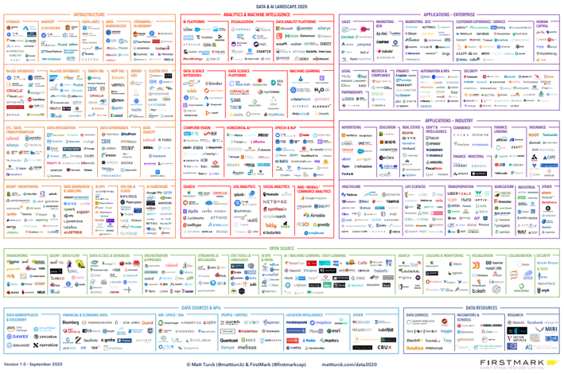
How to succeed
Building It Is Not The Answer
Notes:
Copyright Matt Turke

Slide 6
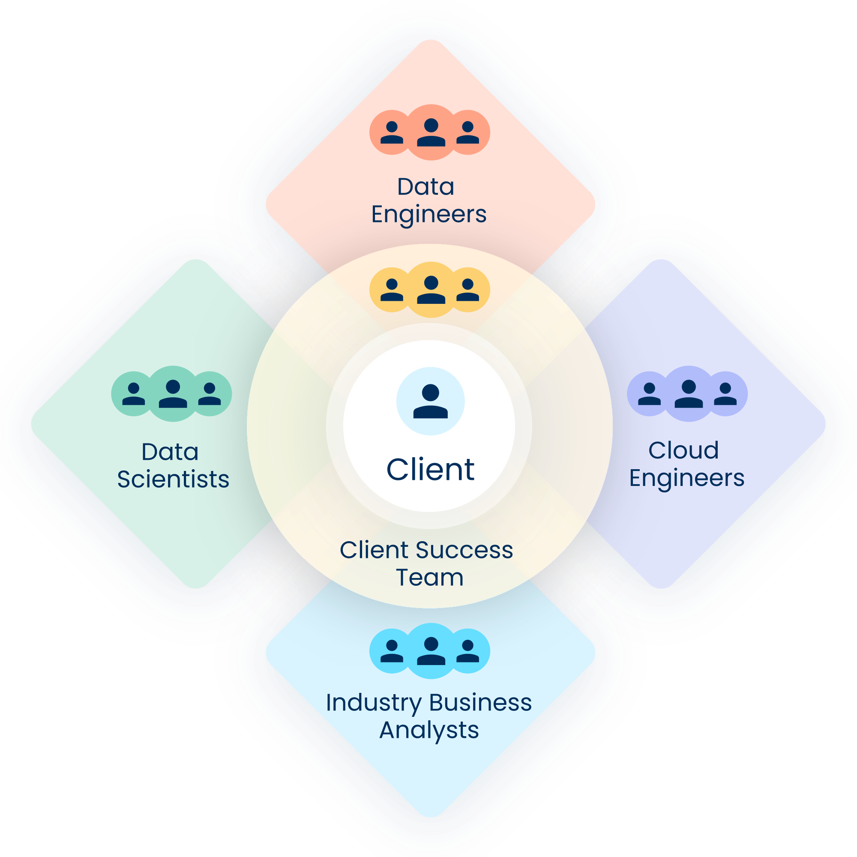
How to succeed
Your IT team needs partners
IT skills are NOT the same as data analytics skills.
Yet, your IT department is filled with helpers who try to figure things out.
You don’t have time to wait for IT to build a solution – what to own vs what to buy
This is a business opportunity driven by technology, not the other way around
Notes:
Your IT department most likely does not include data scientists, cloud architects, data engineers and software developers. This was true even before the Talent War of 2022 where even tech companies are having a hard time finding this talent. The mid-market requires an end-to-end solution that includes both the right technologies and access to expert talent needed for success with analytics and achieving value out of the analytics well beyond implementation milestones being met.

Slide 7
How to succeed
Focus on Business Outcomes: Using Customer Intelligence
Anticipate Needs
Grow Customer Value
Reduce Risk
Increase Operational Efficiency
Notes:
Using Customer Intelligence, we focus on business outcomes including…Anticipating customer needs so you can be proactive with personalized service…Growing customer value by using data to recognize opportunities ready for you to take action…Reducing risk such as loan default, customer churn and crypto fraud…and Increasing operational efficiency with better resource allocation, targeted marketing and sales and reducing waste.

Slide 8
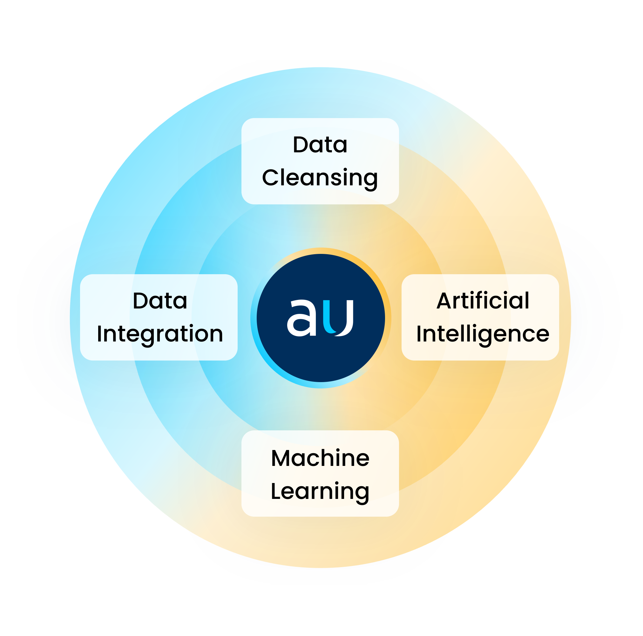
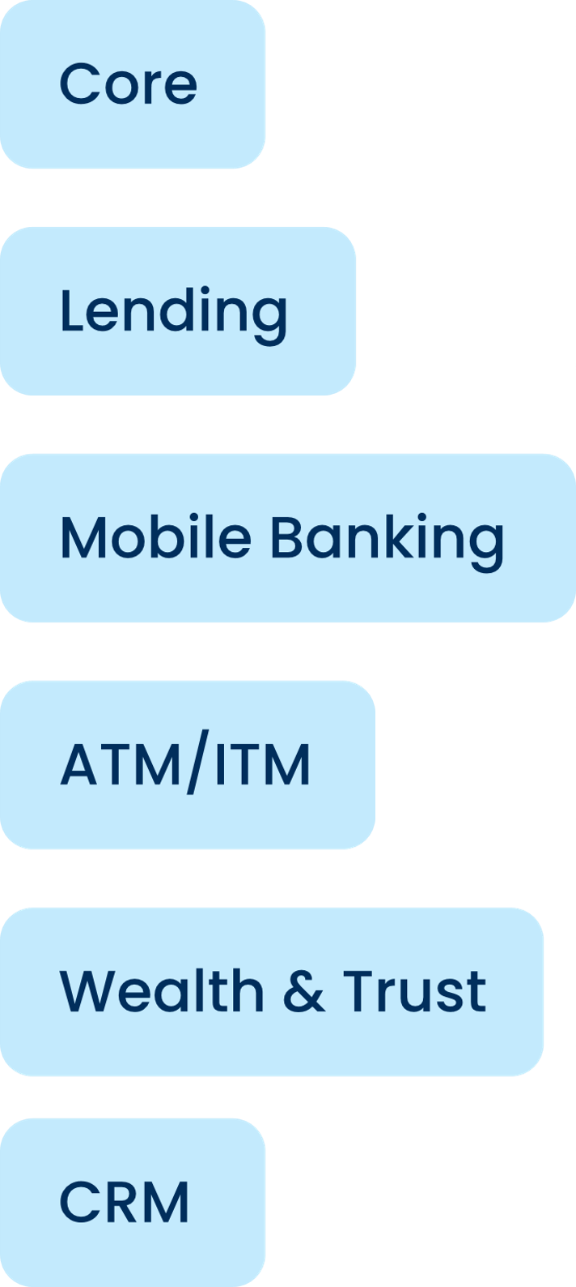
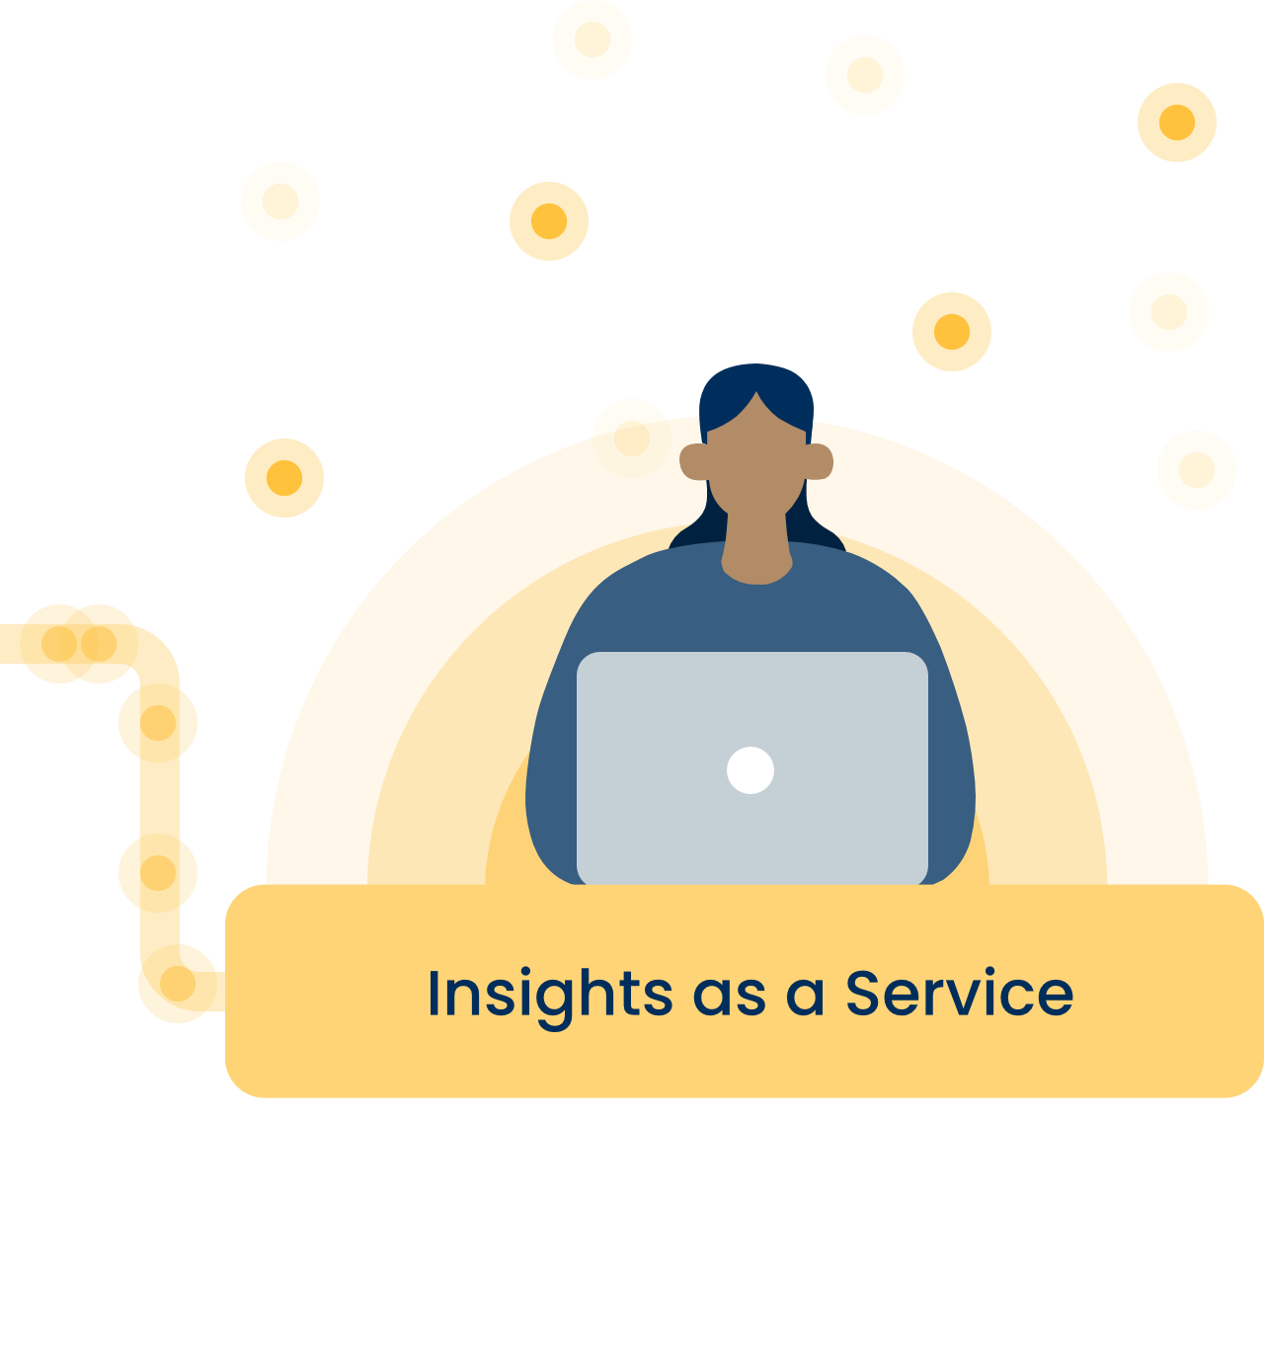
Th
Data Analytics Solution Requirements
You have information all over the place…
Into a single source of truth
So you can get actionable insights about your customers.
that needs to be pulled together
An end-to-end solution from integration to insights.
Notes:
You have information all over the place, we’re pulling that into one single source of truth so that analytics are based upon a complete picture of your data that is cleansed for accuracy so that you can trust the results. Accurate data leads to better decision-making and AI powered insights reveal opportunities in your data.
SOURCES
Consumer lending
Commercial lending
Mobile banking
ATM/ITM
Wealth and trust
CRM
CHANNELS
Specialized Tools
3rd Party Integration
Business Intelligence Integration

Slide 9
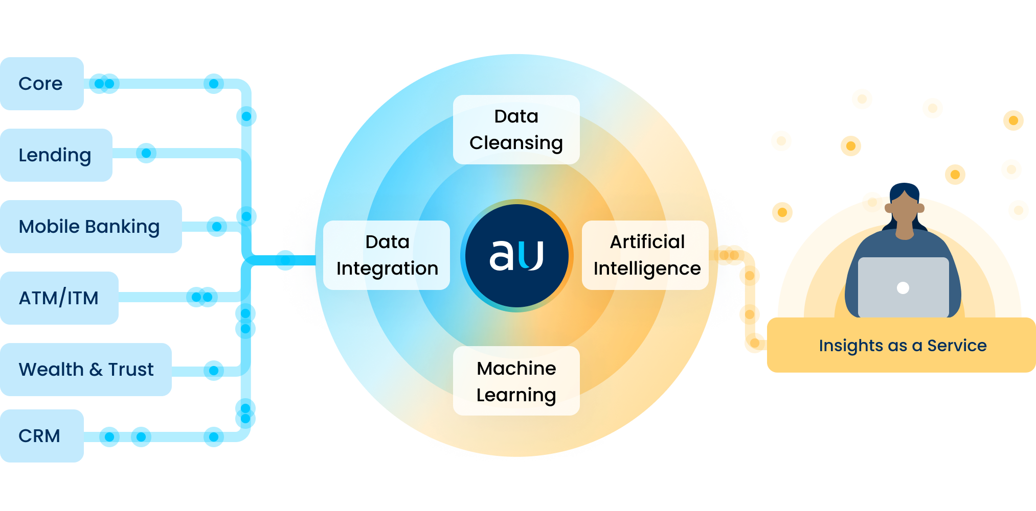
An End-to-End Solution
Data Integration
Bring data sources together for a complete picture of your business
Customer 360
Notes:
Data is cleansed and al the disparate forms and formats translated into a single form to be ready for analytics. Your data management solution should build your data models so that the data is ready for AI. Legacy technologies often started with workshops trying to get everyone in the room to agree on what the data model should look like. Unsurprisingly, most of these projects never got anywhere because the different data owners in the different departments of the bank cojuldn’t agree. Instead, your solution should create a data model to use as a starting place to get results to you faster. You should be able to add to it, edit it as needs change over time and you want to answer new business questions. But this is where you let technology work for you to create your base data model to give faster results.

Slide 10
An End-to-End Solution
One platform
Data management & analytics all in one place
Data cleansed for accuracy and orchestrated to be analytics-ready
Analytics based upon accurate data for trusted insights
AI/ML powered analytics mine your transactional data daily
Notes:
Data is cleansed and al the disparate forms and formats translated into a single form to be ready for analytics. Your data management solution should build your data models so that the data is ready for AI. Legacy technologies often started with workshops trying to get everyone in the room to agree on what the data model should look like. Unsurprisingly, most of these projects never got anywhere because the different data owners in the different departments of the bank cojuldn’t agree. Instead, your solution should create a data model to use as a starting place to get results to you faster. You should be able to add to it, edit it as needs change over time and you want to answer new business questions. But this is where you let technology work for you to create your base data model to give faster results.

Slide 11
An End-to-End Solution
Insights to take action
Insights delivered daily
To the edge
For taking timely action to achieve business outcomes
Notes:
Data is cleansed and al the disparate forms and formats translated into a single form to be ready for analytics. Your data management solution should build your data models so that the data is ready for AI. Legacy technologies often started with workshops trying to get everyone in the room to agree on what the data model should look like. Unsurprisingly, most of these projects never got anywhere because the different data owners in the different departments of the bank cojuldn’t agree. Instead, your solution should create a data model to use as a starting place to get results to you faster. You should be able to add to it, edit it as needs change over time and you want to answer new business questions. But this is where you let technology work for you to create your base data model to give faster results.

Slide 12
Data Management

Slide 13
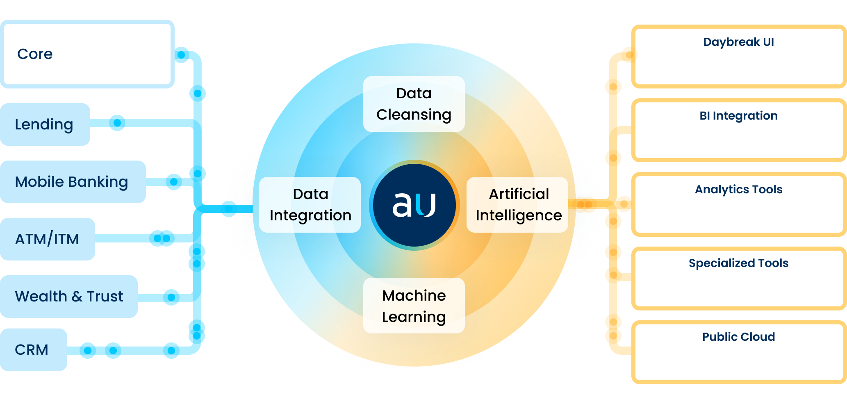
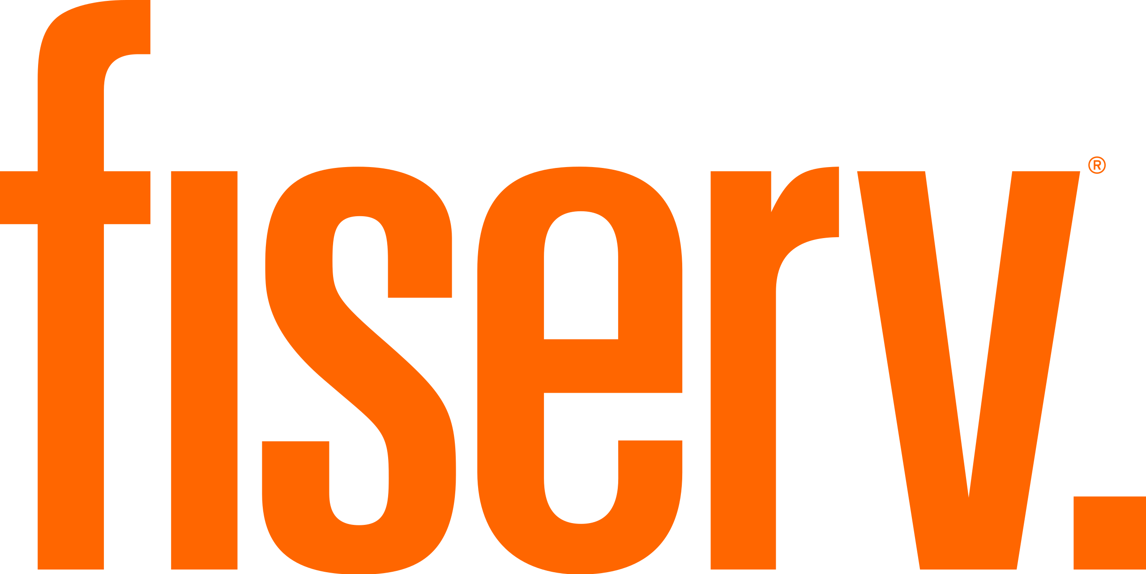
Data Analytics Solution Requirements
…and more
You need a wide variety of connectors and integrations.
Notes:
More technical view. Bottom line is that in order to have data analytics, you need to get your data to the platform. Most analytics companies don’t tell you that building pipelines and maintaining connectors is on you. Instead, you should demand a solution that includes connectors and pipelines, where the vendor is responsible for them. Connectors and integrations should not be huge projects. Modern connectors are API connectors that have capabilities like profiling the data before moving it to properly handle security for financial information, automapping to a data management platform. Old legacy technologies often come with a 6 month data mapping project for each connector and then every time you want ot add a new data source, you are back to a new 6 month project. Modern data management is not about moving your data, but about accessing the data where it lives using secure cloud technologies and API connectors to connect to new data sources in minutes. SOURCES
Consumer lending
Commercial lending
Mobile banking
ATM/ITM
Wealth and trust
CRM
CHANNELS
Specialized Tools
3rd Party Integration
Business Intelligence Integration

Slide 14
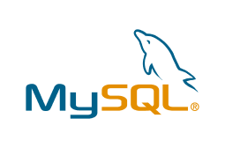
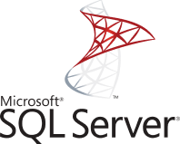
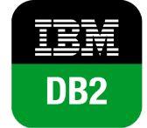
Data Integration and Cleansing
Sampling of Connectors to Demand from a Solution
…and more
Notes:
It is imperative that your data platform is data source agnostic – meaning that it can combine data from multiple types of source systems, in multiple forms and formats. Core technologies alone do not usually do this. They allow you to run reports from the Core but do not add your other data sources or third party data sources into the report. (And they are not predictive – you are only looking at a snapshot of the past.)

Slide 15
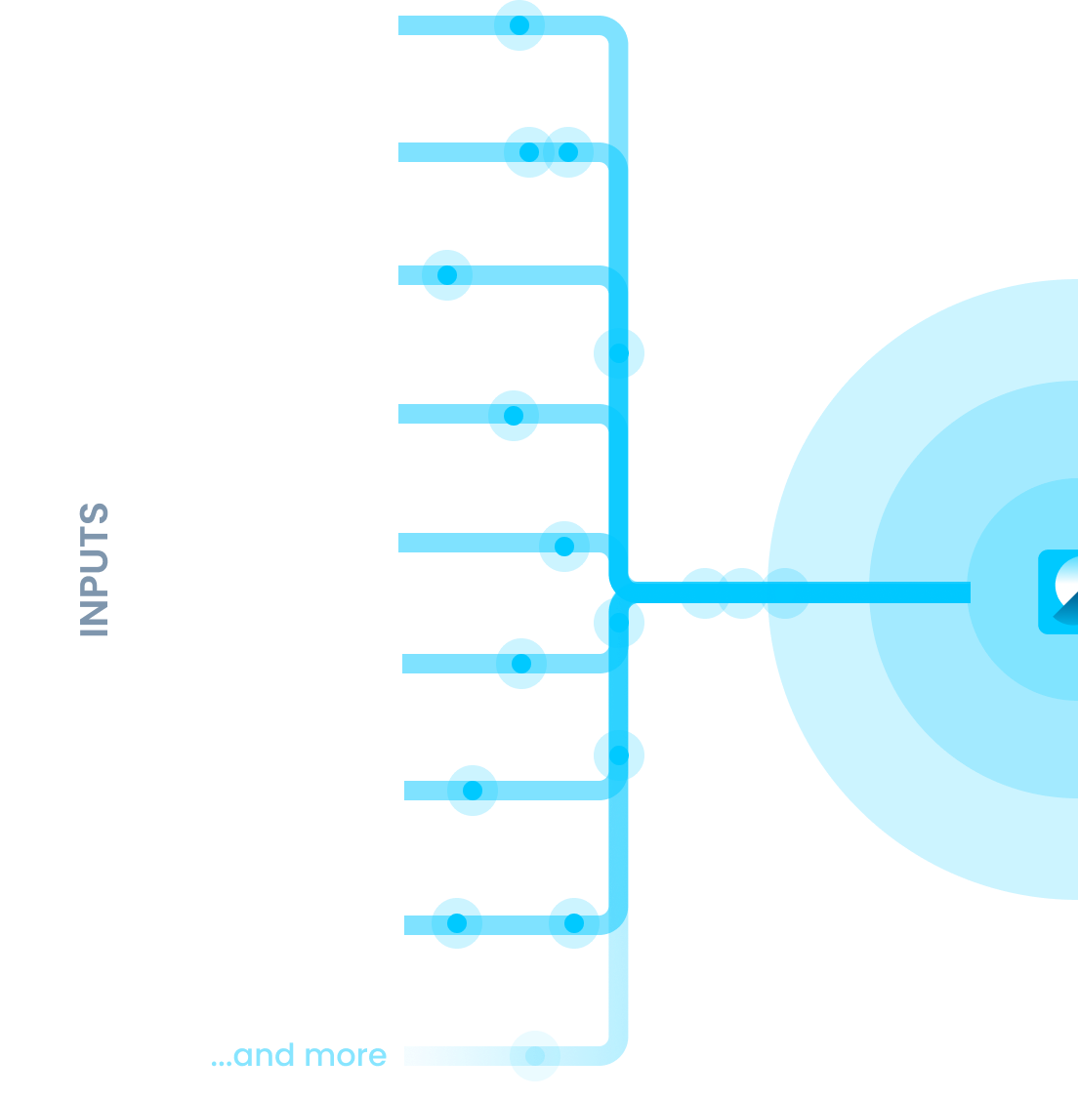
Data Integration and Cleansing
Data Management
Integrate
API plugins to ingest and integrate your data sources and third-party sources in real-time.
Cleanse
ELT/ETL and data quality techniques to cleanse your data to reduce errors and eliminate costly mistakes.
Notes:
Data management has 2 parts. It’s more than just integration. Its also about cleaning up the data, and matching records together about the same customer from multiple systems.

Slide 16
Data Integration and Cleansing
More than Data Integration
What’s Rachel’s address?
System 1
System 2
System 3
Name
Rachel Freeman
R Freeman
Rachel Freedman
Address Line 1
456 North
456 N. Highland Ave.
456 North Highland Ave.
Address Line 2
Highland
-
-
City
Spring Lake
-
Spring Lake
State
MI
MI
-
Zip code
49456
49456
49456-5632
Julie – let’s use these addresses in the Householding section here too.

Slide 17
Data Integration and Cleansing
Data Cleansing for Accuracy
What’s Rachel’s address?
System 1
System 2
System 3
Name
Rachel Freeman
R Freeman
Rachel Freedman
Address Line 1
456 North
456 N. Highland Ave.
456 North Highland Ave.
Address Line 2
Highland
-
-
City
Spring Lake
-
Spring Lake
State
MI
MI
-
Zip code
49456
49456
49456-5632
Julie – let’s use these addresses in the Householding section here too.

Slide 18
Data Integration and Cleansing
Single Source of Truth
What’s Rachel’s address?
Accurate Record
Name
Rachel Freeman
Address Line 1
456 N. Highland Ave.
Address Line 2
-
City
Spring Lake
State
MI
Zip code
49456-5632
Julie – let’s use these addresses in the Householding section here too.
Notes:
Without first making your data accurate, there is no value in data analytics. Garbage in, garbage out. With AI, exponential garbage out.

Slide 19
Analytics

Slide 20
Reminder : Why We Are Digitally Transforming
Why Use Data Analytics for Customer Intelligence
AI increases efficiency of data mining to give you insights beyond what is humanly possible…
…resulting in a tailored and better experience for your customers.
ROI
Tailored Customer Experience

Slide 21
Customer Intelligence for Personalized Service
What do we know about Rachel?
Rachel Freeman
31 years old
Customer for 5 years
720 credit score
Became a customer at Branch 65
Notes:
Let’s go back to our customer, Rachel Freeman. Rachel is 31 years old and has been a customer for 5 years. We know her current credit score, and her credit score when she became a customer at Branch 65. What else do we know about Rachel? What can we learn using AI to mine our transactional data across multiple systems?

Slide 22
Accounts
What accounts does Rachel have?
Checking Account
Active since 6/3/19
Balance of $13,205.20
Auto Loan
Active since 12/14/19
Balance of $22,617.00
Mortgage
Loan amount $350,000
Opened on 3/10/21
Closed on 3/15/22
Notes:
In the datamart, we next layer in an Account Library. Rachel has 2 accounts with our bank. Checking and auto. We can see that she used to have a mortgage account with us with a loan of $350,000, but this account was paid off in a lump sum and closed before the regularly monthly payment schedule ran its course. It looks like the mortgage was refinanced. At first glance, we might want to reach out to Rachel for other services, such as a savings account and a new mortgage. Did one of our competitors win this business away from our bank? Rather than guessing, Daybreak provides customer intelligence so your team has data driven insights for where to act.

Slide 23
Who else is in Rachel’s household?
Brian Weber, 31
456 N. Highland Avenue
HOUSEHOLD ID: 12345
Sara Freeman, 65
456 North Highland Ave.
HOUSEHOLD ID: 12345
Rachel Freeman, 31
456 N. Highland Ave.
HOUSEHOLD ID: 12345
Notes:
Earlier with the Golden Record, we showed how we cleaned up Rachel’s address to be consistent across our systems. Using our Householding Smart Features, we take it a step further. We convert address information to latitude/longiture coordinates. We are able to identify not only different variations of Rachel’s address, but other members of the household. We can see that Rachel lives with Sara Freeman who is 65 and Brian Weber who is 31, who are also customers of our bank.

Slide 24
Target by Household
Actionable Insights
Reduce mailing costs by only sending one mailer to this address.
Know the relationship to a household and not just one individual at a time
Improve the customer experience though personalization.
Rachel Freeman
Notes:
We will make sure that the Marketing department does not send 3 separate mailers to this house for each campaign. In this manner, we are reducing mailing cost and improving customer experience with our bank,

Slide 25
Transactional data and predictive modeling reveal insights.
Notes:
In order to get the insights, we next layer in a transactional data library. Using AI, we are able to mine all transactional data of your bank every night, look for patterns over time and apply predictive modeling for fresh insights delivered every day.

Slide 26
Is money leaving our bank to go to competitors?
Wells Fargo
Monthly outgoing transaction of $1295.68
Fidelity
Monthly outgoing transaction of $400.00
Notes:
The transactional data in Rachel’s checking account reveals that she currently has a mortgage with Wells Fargo. We know how long she has been making payments to Wells Fargo and the payment amount. Based upon this, we can make her a more attractive offer for refinancing the mortgage to win this business back. The transactional data also shows that she has an investment account with Fidelity. Perhaps this is why she does not have a savings account with our bank. We can use this information to approach Rachel with an investment product to grow her business with us and prevent this money from leaving our bank.

Slide 27
Grow Customer Value
Actionable Insights
Make more attractive offer on mortgage to win business back.
Reach out with investment product so that money does not leave our bank.
Rachel Freeman
Notes:
In this manner, using AI we are able to find opportunities to grow customer value that are backed by data. This eliminates the guesswork, and provides focus your sales team to really hit the mark with personalized offers. And we do this at scale for every customer of one across your bank, every day.

Slide 28
More about Sara…
Mortgage
Loan amount $350,000
Opened on 3/15/21
Sara Freeman
HOUSEHOLD ID: 12345
Notes:
On the other hand, if Rachel’s transactional data did not reveal an external mortgage insight, would we approach her for a mortgage offer? Using our Householding technology, what if we learned that Sara Freeman or Brian Weber who lived with Rachel held a mortgage for the property and the mortgage was with our bank. Having this level of insight informs our strategy for growing relationships with existing customers to better anticipate customer needs.

Slide 29
We learn about Rachel’s needs through her transaction history
Debit Transaction
$235.82 at Home Depot on 2/28/22
Debit Transaction
$702.16 at Lowe’s on 3/4/22
Notes:
Mining the transactional data further reveals a new insight. Rachel has been making purchases at Home Depot and Lowes. This shows that a HELOC might be a great product to approach her with.

Slide 30
Has Rachel lost or changed jobs lately?
ACH Deposit
$2,150.00 on 1/15/22
$2,150.00 on 1/30/22
ACH Deposit
$2,600.60 on 2/10/22
$2,600.60 on 2/25/22
$2,600.60 on 3/10/22
Notes:
Got a new job with a raise - offer an IRA

Slide 31
Which products is Rachel most likely to need right now?
Home Equity | 80%
Mortgage | 31%
CD | 67%
IRA | 15%
Line of Credit | 5%
Money Market | 78%
By pulling information from multiple libraries, and applying machine learning and AI, predictions such as the next best product to offer for that customer can be made
Notes:
Based upon daily mining of transactional data, Daybreak provides propensity models for which is the next best product to offer each customer of one. This enables you to reach the right customer at the right time with the right offer.

Slide 32
Anticipate Needs
Actionable Insights
Increase wallet share of current customers by targeting them with the right product at the right time.
Decrease cost of account acquisition by targeting the most likely customers to purchase each product.
Rachel Freeman

Slide 33
Accounts
Before we offer her a loan, how likely is she to default in the future?
Deposit History
Loan History
Defaulter Profile
Risk Propensity
She is unlikely to default
Notes:
But let’s turn this around for a minute. Its not all about targeted marketing, but also about decreasing our risk. AI can be used to predict risk of loan default at the time of application based upon algorithms computing profiles of customers that have defaulted in the past and comparing that to Rachel. So, before reaching out to Rachel with the HELOC offer, we have more information to mitigate risk of default and improve our lending ratios.

Slide 34
Accounts
Is this customer likely to churn in the next 30 days?
Checking Account
Balance dropped from $13,205.20 to $1,400.00 this month.
Auto Loan
Active since 12/14/19
Balance of $22,617.00
Notes:
Rachel has been a customer for 5 years. During this time, we’ve seen a steady monthly deposit schedule from her employer. If that stops, perhaps Rachel has lost her job. This would impact which products our bank would want to offer to her. It also could indicate that she is sending her deposits to another bank. AI gives us an actionable insight by recognizing customers at risk for churn, so that we can reach out to Rachel before we lose her business.

Slide 35
Accounts
Is she making crypto purchases?
Bitcoin
Outgoing
transaction of $1000
XYZ Crypto Exchange
Outgoing
transaction of $2000
Notes:
Data also reveals that Rachel appears to have been making crypto purchases. We can flag her account for fraud risk and reach out to Rachel with crypto risk education. We also need to add this information to our own cybersecurity alerts to protect our bank from bad actors pretending to be Rachel and our employees accidentally clicking on a link or opening an attachment from ”fake Rachel,” which could compromise our own cyber security and allow bad actors in. We know that fraud is common in the crypto industry because it is unregulated. But because there are so many emerging companies, Rachel is less on alert for a new crypto company name to be suspicious. The impact of fraud extends beyond Rachel if someone cleans out her account. Our customer service team is left to deal with the issue and we bear this operational cost.

Slide 36
Reduce Risk
Actionable Insights
Identify the risk of a loan defaulting, assessed at the time the loan is funded.
Reduce loss of deposits by identifying those most likely to move their money to a competitor.
Reach out to customers making crypto purchases to warn of fraud risk and provide information on our safer investment options; reduce our cyber risk.
Rachel Freeman

Slide 37
How does she prefer to be contacted?
Signed up for eStatements
Sent a mailing – no response
Notes:
We also mine customer interaction data to show utilization by a customer of online and digital services. This reveals actionable insights to which channels are the best for reaching your customers. For example, if Rachel opted in for estatements, she most likely would respond better to email marketing than mailed postcards. Service analysis also provides insights for operational reporting to better understand utilization and identify areas for future investment.

Slide 38
Which branch does she visit most often?
Teller Transaction
Branch 12
3/17/22
Teller Transaction
Branch 12
2/14/22
Teller Transaction
Branch 12
3/20/22
Notes:
Similarly, analytics reveal insights for branch utilization, allocation and reallocation. Often a customer opens an account at one branch but does more transactional banking at a different branch. For example, Rachel opened her account at branch 65, which was downtown near her place of employment. But, during the pandemic the majority of her banking switched to branch 12, close to her home. When customers change employment or move their residence, they start using different branches. The old banking model of attributing a customer to the origination branch does not really work for assessing branch profitability and operational needs. Daybreak analyzes utilization data to better inform staffing needs.

Slide 39
Which are my most valuable customers?
80
16
71
Customer value scores calculated based on a large number of relevant factors using AI and Machine Learning.
41
58
19
42
24
Notes:
Ultimately, we want to grow business from high value customers. Using algorithms, we can predict who will be your most valuable customers, so that you can focus your attention on building high value relationships that will yield growth,

Slide 40
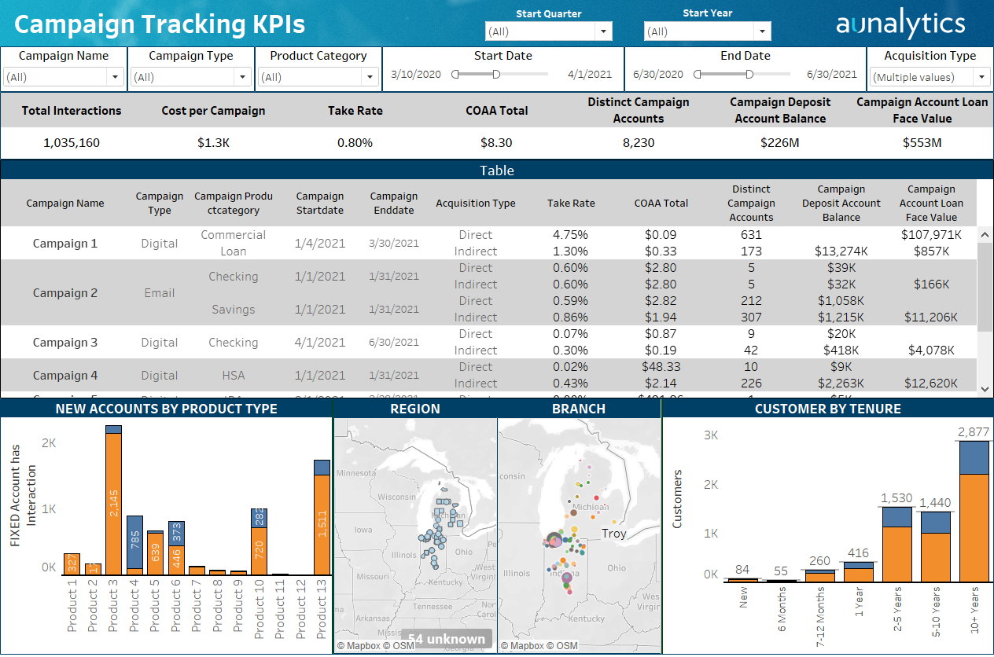
Which Campaigns are Effective?
Notes:
Data analytics tracks marketing campaigns to new products sold so you can do more of what works and less of what doesn’t work.

Slide 41
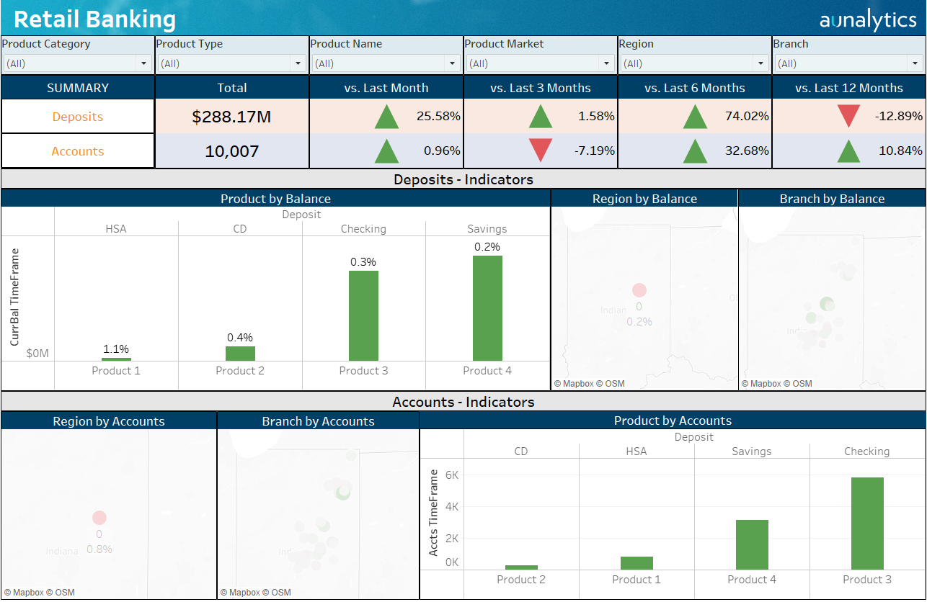
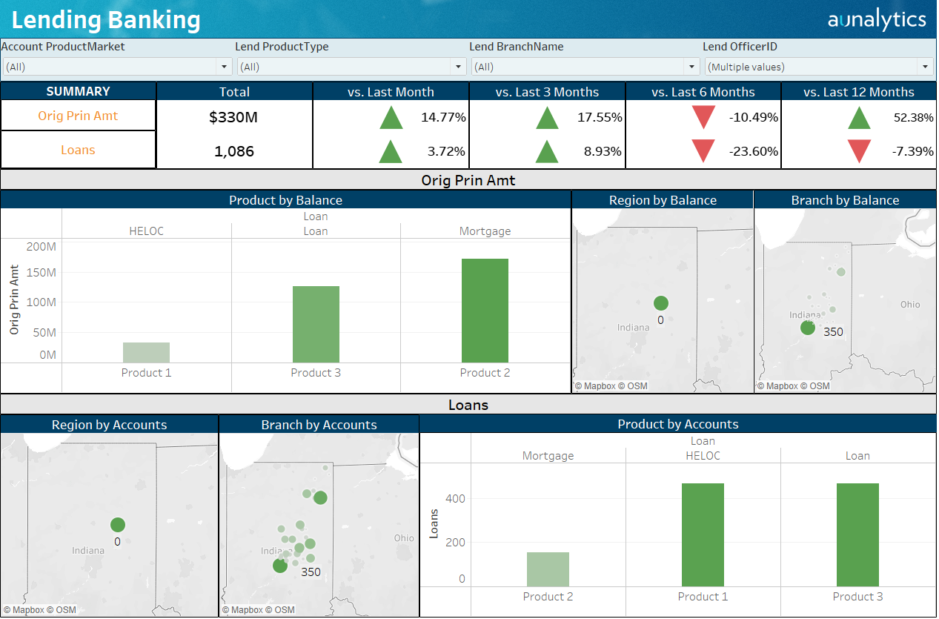
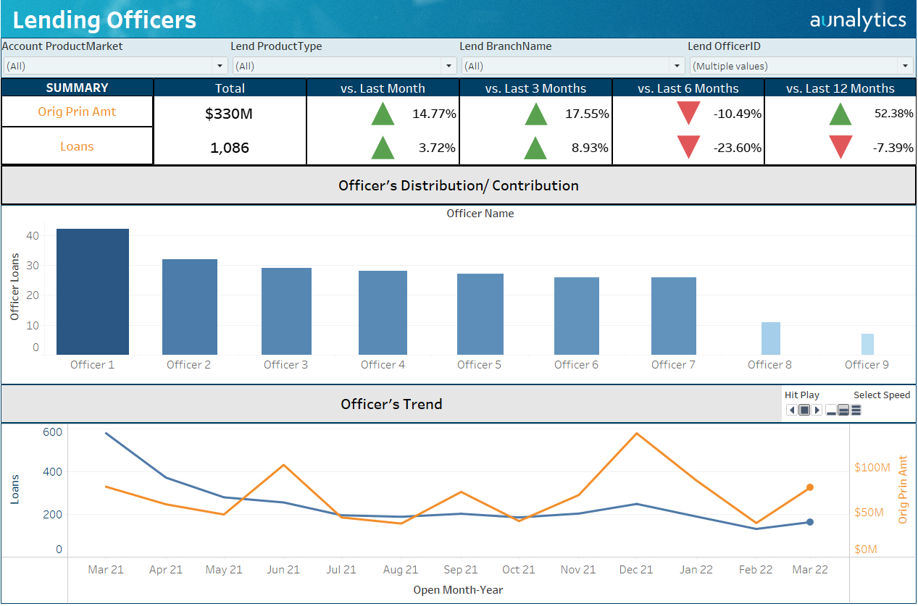
KPI Tracking for Your Team
Notes:
Insights based upon clean trusted data populate KPI dashboards for your team.

Slide 42
Improve Operational Efficiency
Actionable Insights
Reach out to customers using the channel they prefer.
Reassign customers to their most active branch for better branch operations planning.
Allocate resources to target customers with higher customer lifetime value scores.
Smarten up your marketing campaigns by using data to drive effectiveness.
Rachel Freeman

Slide 43
Personalized Customer Experience
Customer retention and growth
Targeted Sales/Marketing
Reduced Risk
Gained Operational Efficiencies
ROI
Rachel Freeman
Notes:
Putting it all together, using data to drive decision-making and service results in better customer retention, growth, targeted sales and marketing, reduced risk to our institution and more efficient operations. Analytics allows you to prevent money from leaving your institution, grow customer loyalty by using insights to inform your personalized services.

Slide 44
Analytics at Scale
Rachel is one of many.
Daily insights for all customers.
SERVICES LIBRARY
TRANSACTION LIBRARY
ACCOUNT LIBRARY
customer LIBRARY
Your data tells a story. Find the opportunities in your data.
Notes:
Using AI and Machine Learning, we put insights in front of your team every morning about every customer. We enhance your personalized white glove service by backing it with data and insights to efficiently grow revenue and cut costs.

Slide 45
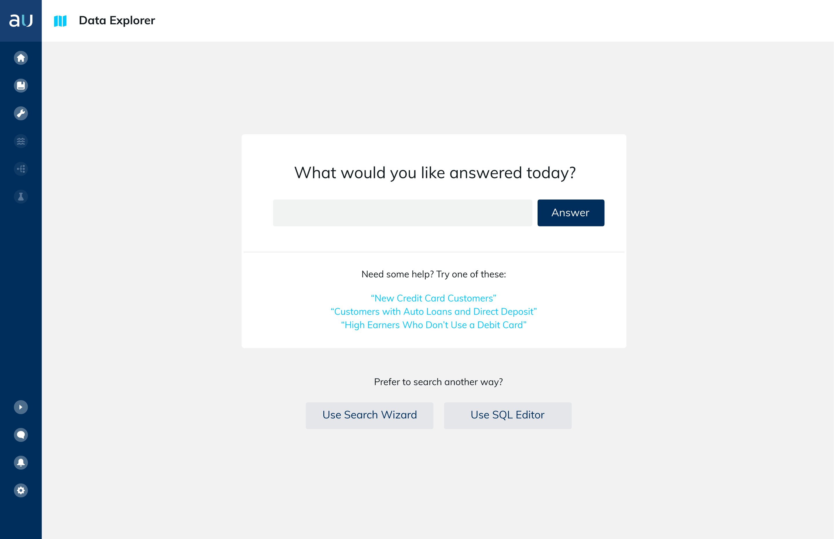
A new era for analytics

Slide 46
Rich Carlton, President
Rich.Carlton@aunalytics.com

