Slide 1
Building a Winning Team
Module 13

Slide 2
Module Objectives:
After completing this module, you will:
Understand the definition, rationale and purpose of teams
Be able to describe the components of effective teams
Know ho to define your role as a leader and team builder
Understand common team issues and challenges

Slide 3
Teams: Why Do We Have Them?

Slide 4
Work Teams Defined
A small number of people who: interact face-to-face or virtually, share a common understanding of an interdependent goal, are mutually influential, and express a sense of belonging.
A group of people who work together to achieve a desired goal.
Research shows that although individuals need not be well rounded teams should be.
Notes:
Why do teams matter???

Slide 5
What are the three formal characteristics of a work team?
The need to accomplish something.
The need to develop and maintain working relationships among the members.
The need of each member to have their individual contributions valued and have a sense of accomplishment.
The ideal work group size is between 5-7 people.
Work groups should be less than 15 members to be effective.

Slide 6
What are the 4 domains of Strengths-Based Teams?
Executing
Knowing how to make things happen
Influencing
Speaking up, taking charge, and making sure the group is heard.
Relationship Building
Creating groups that are more effective as a whole than individual contributors
Strategic Thinking
Keeping the discussion centered around what could be possible
Source: Strengths Based Leadership by Tom Roth, pg. 22-27

Slide 7
What makes a great team leader?
What team leader within your bank has had the most positive influence on your daily life? Once you have someone in mind, please list his or her initials.
Now, please list three words that best describe what this person contributes to your team.
__________________________
__________________________
__________________________
Source: Strengths Based Leadership by Tom Roth, pg. 80-81
Notes:
Think of a teacher if you cannot think of someone.

Slide 8
Followers’ Four Basic Needs
Trust
Honesty, Integrity, Respect
Compassion
Caring, Friendship, Happiness, Love
Stability
Security, Strength, Support, Peace
Hope
Direction, Faith, and Guidance
Fact: Employees who have high confidence in their company’s financial future are nine times as likely to be engaged in their jobs when compared to those who have lower confidence about their organization’s financial future.
Please see handouts within module for effective and ineffective teams information and checklists.
Source: Strengths Based Leadership by Tom Roth, pg. 82-83
Notes:
Think of a teacher if you cannot think of someone.

Slide 9
Build Your Team

Slide 10
Many new leaders stumble when it comes to building teams.
Notes:
Think of a teacher if you cannot think of someone.

Slide 11
Common New Leader Pitfalls
Criticizing the previous leadership.
Keeping the existing team too long.
Not working on organizational alignment and team development in parallel.
Not holding on to good people.
Undertaking the team building before the core is in place. (We’ll learn about how teams form next).
Trying to do it all yourself.
Source: The First 90 Days by. M. Watkins, pg. 167.
Notes:
Think of a teacher if you cannot think of someone.

Slide 12
How do you evaluate your team members?
Competence
Does this person have the technical competence and experience to do the job effectively?
Judgement
Does this person exercise good judgement, especially under pressure or when faced with making sacrifices for the greater good?
Energy
Does this team member bring the right kind of energy to the job, or is she/he burned out or discouraged?
Source: The First 90 Days by. M. Watkins, pg. 171.
Notes:
Think of a teacher if you cannot think of someone.

Slide 13
How do you evaluate your team members?
Focus
Is this person capable of setting priorities and sticking to them, or prone to riding off in all directions?
Relationships
Does this individual get along with others on the team and support collective decision making, or is she/he difficult to work with?
Trust
Can you trust this person to keep his/her word and follow through on commitments?
Source: The First 90 Days by. M. Watkins, pg. 171.
Notes:
Think of a teacher if you cannot think of someone.

Slide 14
Have a conversation with each team member.
Prepare for the meeting.
Review available personnel history, performance data, and other appraisals.
Familiarize yourself with this individual’s technical and professional skills.
Assess their goals, reasons for being at the bank, dreams.
Source: The First 90 Days by. M. Watkins, pg. 175.
Notes:
Think of a teacher if you cannot think of someone.

Slide 15
Have a conversation with each team member.
Create an interview template.
What are the strengths and weaknesses of our project, existing strategy?
What are the biggest challenges and opportunities facing us in the short-term? In the long term?
What resources could be leverage more effectively?
How could we improve the way the team works together?
If you were in my position, what would your priorities be?
Source: The First 90 Days by. M. Watkins, pg. 176.
Notes:
Think of a teacher if you cannot think of someone.

Slide 16
Have a conversation with each team member.
Look for verbal and nonverbal cues.
Notice what a person says and does not say.
Does the person volunteer information or do you have to extract it?
Does the person take responsibility for problems on the team, if applicable?
Make excuses or point out other team member’s flaws?
Notice the person’s facial expressions and body language.
Notice how team members interact outside of team meetings.
Do relationships appear cordial and productive?
Tense and competitive?
Judgmental or reserved?
Source: The First 90 Days by. M. Watkins, pg. 182.
Notes:
Think of a teacher if you cannot think of someone.

Slide 17
Align Your Team and Set the Structure
Participant Roles
What is the group expectation for interaction? How do you ensure all voices are heard? What are the norms for communication?
Team meetings
How often do we meet? Who sets the agendas for meeting? How do we celebrate achievements?
Decision making
Who makes the final decision? How do we support decisions?
Leadership Style
Situational Leadership, Your Leadership Style, Team Member Styles, Setting Expectations and Project Scope
Source: The First 90 Days by. M. Watkins, pg. 190, as adapted.
Notes:
Think of a teacher if you cannot think of someone.

Slide 18
Stages of Team Development

Slide 19
Stages of Team Development
Forming
Storming
Norming
Performing

Slide 20
Stages of Team Development: Forming
Overview | Typical Behaviors | Appropriate Leader Tasks
During the first stage, forming, team members establish interpersonal relationships, become familiar with the assigned task (the group assignment) and create ground rules. | Task: Orientation Maintenance: Testing and Dependence | Getting to know activities Group introduction Use of ice breakers Structured meetings Strong leadership presence
Note: At this stage, structure and inclusion should be high.

Slide 21
Stages of Team Development: Storming
Overview | Typical Behaviors | Appropriate Leader Tasks
During the second stage, storming, marks a time of intra-group conflict due to lack of group unity. Because team members still see themselves as individuals rather than as part of a team, they may resist the formation of group structure in favor of expressing their individuality. | Task: Emotional response to task demands Maintenance: Intra-group conflict | Lessen leadership presence Manage conflict Begin using strengths and limitations towards group success
Note: At this stage, inclusion should remain high but structure can be lessened.

Slide 22
Stages of Team Development: Norming
Overview | Typical Behaviors | Appropriate Leader Tasks
The third stage, Norming, is characterized by the emergence of group harmony as group members begin to openly express ideas and opinions. Members begin to accept teammates for who they are and task-related conflicts are avoided in an effort to preserve harmony. | Task: Expression of opinions Maintenance: Intra-group conflict | Allow team members to use personal strengths and enhance limitations toward group success Give team members and team autonomy on group tasks Encourage group diversity on all levels such as communication, project work, etc. Begin to act as a resource person or advisor
Note: At this stage, inclusion and structure can be low.

Slide 23
Stages of Team Development: Performing
Overview | Typical Behaviors | Appropriate Leader Tasks
The final stage, performing, reflects a period of productive collaboration in which members demonstrate support for each other and assume roles that will enhance task activities. Constructive attempts are made to resolve any issues related to the completion of the task. | Task: Emergence of solution Maintenance: Function role-relatedness | Be a resource person and advisor Facilitate overall group vision and group purpose
Note: At this stage, inclusion and structure are low.

Slide 24
Situational Leadership and Team Building

Slide 25
Situational Leadership Defined
Provides leaders with an understanding of the relationship between an effective style of leadership and the level of readiness that followers exhibit for a specific task.
There are for Situational Leadership Styles
S1 – Directing
S2 – Coaching
S3 – Supporting
S4 - Delegating

Slide 26
Situational Leadership Overview
Developed by Paul Hersey in 1960 – Likely the most recognized leadership model.
Teaches you how to adopt the appropriate leadership style to match the situation.
Expands your range of leadership styles.
Helps you identify the development level of your employees and match your leadership style to that employee’s level of development.
There are 4 Leadership Styles and 4 Development Levels; very effective tool for team building.

Slide 27
Situational Leadership – 4 Development Styles
D4 The Self-Reliant Achiever | D3 The Capable, but Cautious, Performer | D2 The Disillusioned Learner | D1 The Enthusiastic Beginner
Recognized by others as an expert Consistently competent; justifiably confident Trusts own ability to work independently; self assured Inspired; inspires others Proactive; may be asked to do to much | Is generally self-directed but needs opportunities to test ideas with others Sometimes hesitant, unsure tentative Not always confident; self critical; may need help to look at skills objectively Makes productive contributions | Has some knowledge and skills; not competent yet Frustrated; may be ready to quit Discouraged, overwhelmed, confused Developing and learning; needs reassurance that mistakes are a part of the learning process Unreliable, inconsistent | New to the task or goal; inexperienced Eager to learn; willing to take direction Enthusiastic, excited, optimistic Don’t know what they don’t know, so they may do the wrong thing Confidence based on hopes and transferrable skills, not reality
Notes:
Facilitator Notes: We also need to take into account the competency a person has related to the task. Review each column with the group and share a situation – see below.
D1- Here an employee might be new to their role or they have been in their job for a long time but this particular task is new to them. Anytime an employee is truly new to a task and has little job knowledge, the employee would be considered a D1.
D2- The employee has some knowledge of the task, but for some reason perhaps a lack of resources available to do they job, they have become frustrated or are underperforming from what usually has been excellent performance.
D3 – The employee has knowledge to do the task but in this situation wants some feedback from the boss on his ideas or wants to brainstorm or share ideas with colleagues.
D4 = The Expert – this person knows his/her job well and you can just tell them what needs to get done and let the employee do it. Many of you have tasks that you do daily that fall into this category.

Slide 28
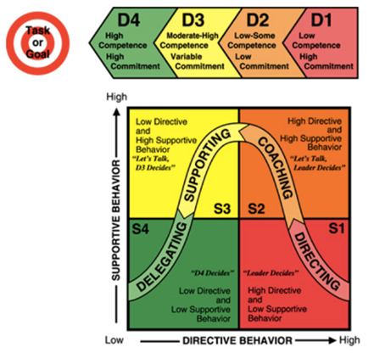
Making the Match
Employee Need
Leadership Style
Notes:
Here we are now matching the employees development or behavior with the appropriate leadership style. The color coding makes this process easier. If you employee is a D1 meaning they are enthusiastic but have little skill to do the job, then we apply the management style of S1 – lots of directing – telling the employee exactly and step by step how to do the task and what our expectations as leaders are. Consider this “hand holding”

Slide 29
Let’s see you apply what you learned….
Scenario 1:
Jennifer, a recent hire, is very enthusiastic about her new job with the bank. She has indicated that she is willing to go above and beyond what it takes to learn and grow.
She has been hired to assist in the design and development of a social media strategy for millennials.
Prior to her arrival, your team developed a series of standards and guidelines to be used for all online marketing.
Jennifer has excellent technical skills, yet has not worked with a team before. In order to assure Jennifer’s success, you would use the ______________________________ leadership style.

Slide 30
Answer
Scenario 1:
S1 – Directing since employee is a D1 being a new hire.

Slide 31
Let’s see you apply what you learned….
Scenario 2:
Kevin is a top performer in your department. He has been employed in the department for six years.
Recently, as a result of customer feedback, you identified the need for several changes in the department which will impact processes and procedures in Kevin’s area.
You need to bring Kevin on board so that the change will go smoothly and the department will achieve greater success. In this situation, you would utilize the __________________________ leadership style.

Slide 32
Answer
Scenario 2:
S4 – Delegating since employee is a D4 being an expert and top performer in his current role.

Slide 33
Let’s see you apply what you learned….
Scenario 3:
Gretchen has been with your department for two years. In the past she has always been an excellent employee.
However, in the past six months, you’ve noticed a change in the quality and quantity of her work. Errors have been made on important documents and spreadsheets.
You will meet with Gretchen this morning and will use the _________________ leadership style to address the situation.

Slide 34
Answer
Scenario 3:
S2 – Coaching since she has had previous good performance but now errors have emerged. If coaching style does not address situation satisfactorily, move to S1 – Directing style until performance improves.

Slide 35
Let’s see you apply what you learned….
Scenario 4:
You recently had significant turnover in your department.
As you review your team of fifteen people, seven are recent hires.
Considering the staff changes in your department and the fact that it is crucial that the team works well together, you are concerned about the team’s cohesiveness.
You will be utilizing the ________________________________ leadership style to assure that this new team gets off to an excellent start.

Slide 36
Answer
Scenario 4:
S3- Supporting since you have a mix of ½ new staff and existing staff. However, you would use a S1 for the recent hires.

Slide 37
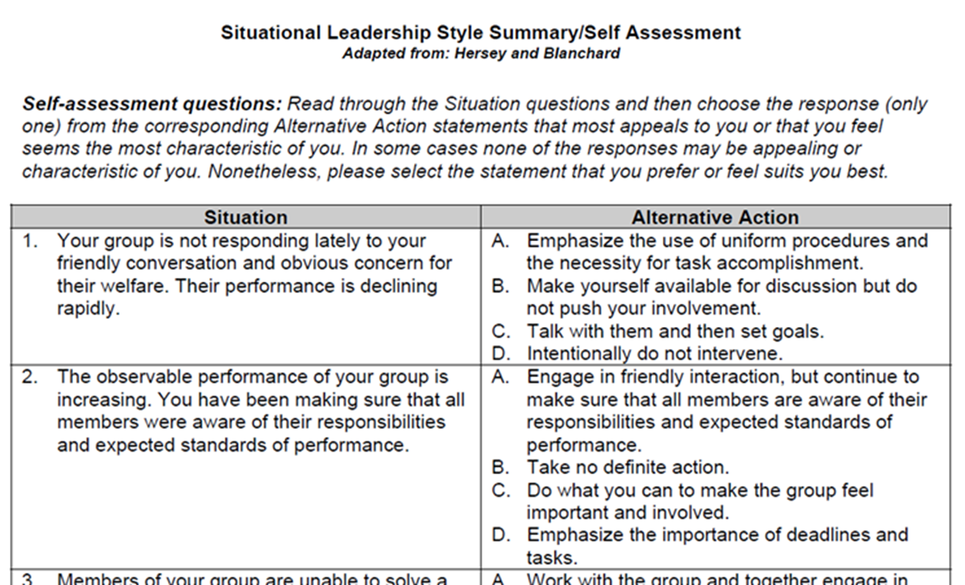
Situational Leadership Self Assessment

Slide 38
Suggested Resources
The Five Dysfunctions of a Team by Patrick Lencioni
Situational Leadership You Tube: https://www.youtube.com/watch?v=5LBC4eunkHo
Strengths Based Leadership by Tom Roth
The First 90 Days by Michael D. Watkins
How Managers Become Leaders, Michael Watkins, Harvard Business Review, June 2012.

