Slide 1


Cultivate a Champion Mindset
Module 8
Professionalism and Emotional Intelligence

Slide 2
Module Objectives:
By the end of this module, you will:
  Understand workplace and office etiquette.
  Learn how to build your professional wardrobe on a budget and the value of classic pieces for men and women.
  Gain insights into why Emotional Intelligence matters at work and how you can increase your own EQ value.

Slide 3
Agenda
Professionalism in the Workplace
The Key Attributes of Being a Professional: Dress, Behaviors, Attitudes, and Results
Emotional Intelligence at Work
How to Apply EQ as a Manager
A Manager vs. Employee Mindset

Slide 4
Professionalism In The Workplace
Key Characteristics

Slide 5
Professionalism Defined
Professionalism can lead to respect, raises, promotions and better performance.
It's not a single act, but a collection of behaviors and presentations that show you're dependable, focused on your work, understand how to coexist with all kinds of different people in a respectable manner and areopen to improvement.
A lack of professionalism will likely cause your career to stall out soon after it shifts into first.
What does workplace professionalism mean to you?

Slide 6
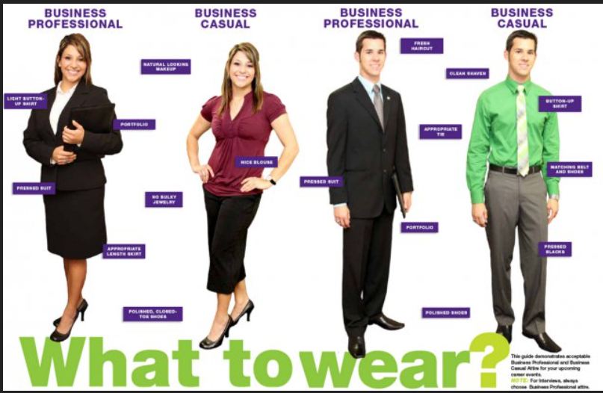
Dress for Success
Please see handouts within module for additional dress for success tips!

Slide 7
Use Proper Etiquette
Focus on being respectful when interacting with your co-workers, superiors, and prospective customers whether you like them or not and even when you are having a bad day.
Keep your workspace and shared areas clean and neat.
If you share several office spaces, make sure all co-workers understand your filing or organization system.
Don’t RSVP for an event, then not show. This is not just rude, but will also cost the host money, and you’ve probably prevented someone else from attending.
Manners count: Please and Thank you go a long way.
Please see handout for more workplace etiquette.

Slide 8
Be Punctual
Did you know? About 15% of Americans arrive late for work at least once per week.
Be Punctual: It shows you are capable of honoring your word while projecting a sense of commitment toward your job, to your co-workers, and of professionalism in general.
Send a text if you are going to arrive late or call. However, you should make every effort to arrive on time or a few minutes before a meeting or appointment.

Slide 9
Use Tact
Whether you're a manager who appraises employees every six months or an employee who's trying to help a co-worker improve, the use of tact to diffuse awkward and tense situations is a sure sign of professionalism.
Avoid the brutal truth, and instead look to approach situations diplomatically.
For example, suppose an employee your supervise needs to work on getting tasks done in a timelier manner. Don't tell him/her s/he has poor time management skills or infer that the employee is lazy. Instead, take the more professional approach: explain that you've noticed s/he often experiences delays in completing work, and then have a two-way conversation regarding tactics for improvement.

Slide 10
Be Organized and Dependable
Organization is the core principle of professionalism and cannot be stressed enough.
Learn how to prioritize so work gets done on time and demonstrates you are a professional who takes work seriously.
Complete projects and tasks on time and at a consistently high level. Put forth your best effort no matter what you do, even if personally you consider the undertaking small and insignificant. Make sure your word is true and that you don't promise something you can't fulfill.
Organized employees are more productive, make better impressions on their supervisors, and receive more promotions than their disorganized counterparts.

Slide 11
Communicate Effectively
Exude professionalism by speaking clearly no matter who you are speaking with.
Remember that communication is a two-way street, so allow the other person or persons to reciprocate, and always listen. Don't think about what you're going to say next, or let their words go in one ear and out the other.
Your written communications should similarly reflect professionalism. Avoid excessive use of acronyms and jargon, avoid emoticons and get to the point without being too blunt.
Read over everything you write to make sure the message is clear and the tone won't be misread as being harsh or unfriendly.
You’ll learn more about Communication strategies in an upcoming module.

Slide 12
Be Open to Criticism
Closing yourself off to criticism or responding poorly to it tells others you are not professional enough to acknowledge imperfections. Be open to criticism. That is applicable for managers and employees alike.
Although managers are often thought of as doling out criticism, the best and most professional ones accept criticism from their employees.
If you disagree with the criticism, acknowledge it, but don't immediately rebuke it or say something you might regret. Take a day or two and think it over. You might find there's some truth in what was said.
Source: https://careertrend.com/13360976/how-to-demonstrate-professionalism

Slide 13
Show That You are Dedicated To Your Job
Demonstrate to others that you have a strong work ethic.
Deliver strong results – credibly.
Go the extra mile now and then by picking up that assignment everyone else is avoiding and by helping your coworkers or managers out when needed.
Demonstrate that you are someone who is open, honest and transparent. When you make a mistake, own up to it.
Establish expertise at your job. Become known as the “go to person.”
Be generous at work and be a collaborator.
Be clear, be consistent, and be creative with a capacity to learn.

Slide 14
Emotional Intelligence at Work

Slide 15
Emotional Intelligence Defined
Emotional Intelligence is the ability to identify and manage your own emotions and the emotions of others.
It is generally said to include these skills: emotional awareness; the ability to harness emotions and apply them to tasks like thinking and problem solving; and the ability to manage emotions, which includes regulating your own emotions and cheering up or calming down other people.

Slide 16
Emotional Intelligence Defined
“an array of non-cognitive capabilities, competencies and skills that influence one’s ability to succeed in coping with environmental demands and pressures”
— Reuven BarOn
“the ability to perceive emotions, to access and generate emotions so as to assist thought, to understand emotions and emotional meanings, and to reflectively regulate emotions in ways that promote emotional and intellectual growth”
— Salovey & Mayer
“the capacity for recognizing our own feelings and those of others, for motivating ourselves, and for managing emotions well in ourselves and in our relationships”
— Daniel Goleman

Slide 18
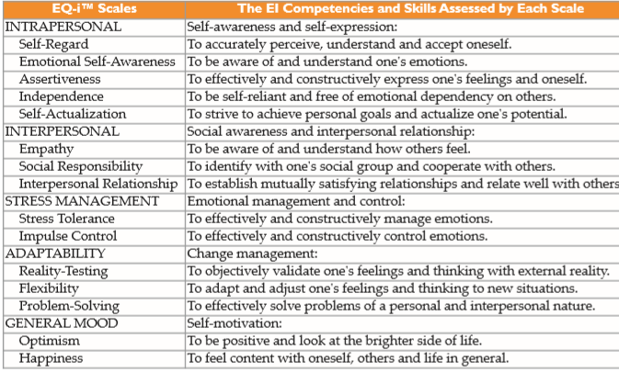
Notes:
Source: http://www.eiconsortium.org/pdf/Bharwaney_BarOn_MacKinlay_EQ_and_Bottom_Line.pdf

Slide 19
The Foundation
and results in
Personal & Interpersonal Effectiveness
Self-Actualization
Happiness
which predicts
Effective Relationships
Interpersonal
Relationships
Independence
is related to
Interpersonal Skills
Empathy
Social Responsibility
Assertiveness
plus
Coping Skills
Impulse Control
Stress Tolerance
Problem Solving
Flexibility
Optimism
Self Awareness
Emotional Self-Awareness
Self-Regard
Reality Testing
Source: Adapted from: The Cannon Emotional Competence Model
Kate Cannon, Author

Slide 20
How Does EQ Differ from IQ
EQ | IQ
Focus: Develop an understanding of and an ability to manage emotions | Focus: Develop one’s cognitive abilities; more academically oriented
Understood to be an important predictor of one’s potential for success. | Has been traditionally used to predict potential for one’s success.
Fosters an understanding and management of own emotions | Allows development of needed knowledge base
Promotes positive relationships | Enables development of technical skills and abilities
Increases self-motivation and drive | Enables conceptional thinking

Slide 21
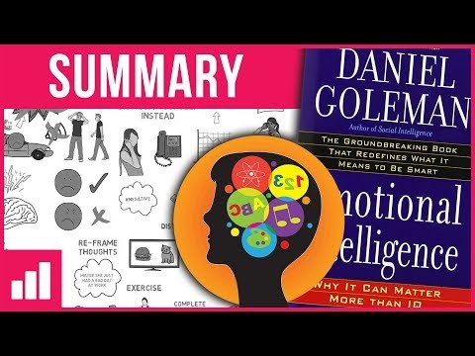
Emotional Intelligence in the Workplace - Video
Notes:
Show Video Twice so Students learn the concepts
Facilitator Notes: This is a short 7 minute video which demonstrations how to use EQ in the workplace. I might reference that the workbook on pages 64-67 invites you to evaluate your current state of emotional intelligence. This is a short video to bring this concept to life. Daniel Goleman is the most famous person to bring EQ into the workplace.
Video Link from YouTube: https://www.youtube.com/watch?v=n6MRsGwyMuQ

Slide 22
EQ Video – Recap
Daniel Goleman 5 Key Concepts:
Self-Awareness
Self-Regulation
Internal Motivation
Empathy
Socials “People” Skills
What were some of the lessons you learned from watching the video?

Slide 23
EQ - 5 Primary Categories
Self-awareness: If a person has a healthy sense of self-awareness, he understands his own strengths and weaknesses, as well as how his actions affect others. A person who is self-aware is usually better able to handle and learn from constructive criticism than one who is not.
Self-regulation: A person with a high EQ can maturely reveal her emotions and exercise restraint when needed. Instead of squelching her feelings, she expresses them with restraint and control.
Motivation: Emotionally intelligent people are self-motivated. They are not motivated simply by money or a title. They are usually resilient and optimistic when they encounter disappointment and driven by an inner ambition.

Slide 24
EQ - 5 Primary Categories
Empathy: A person who has empathy has compassion and an understanding of human nature that allows him to connect with other people on an emotional level. The ability to empathize allows a person to provide great service and respond genuinely to others’ concerns.
Simon Sinek: Empathy YouTube Video: https://www.youtube.com/watch?v=pi86Nr9Mdms
People skills: People who are emotionally intelligent are able to build rapport and trust quickly with others on teams. They avoid power struggles and backstabbing. They usually enjoy other people and have the respect of others around them.

Slide 25
Emotional Intelligence at Work
A consensus of findings in the studies summarized to-date using the EQ-i™ BarOn indicate that the most powerful EI contributors to occupational performance are:
a)the ability to be aware of and accept oneself;
b)the ability to be aware of others' feelings, concerns and needs;
c) the ability to manage emotions;
d)the ability to be realistic and put things in correct perspective; and,
e) the ability to have a positive disposition and outlook on life.

Slide 26
Applications of EQ at Work
EQ Profiling of Occupations and Star Performers at Work
Recruitment and Selection (“Hiring Talent”)
Group Training and Team Development
Coaching and Mentoring
Succession Planning
Pulse reading before or after an organizational change
Mergers and Acquisitions

Slide 27
Characteristics of a High Performing EQ Team
Work in collaboration
Higher productivity
Improved morale
Increased employee tenure
Increased job satisfaction
Use of humor as a strategy
Job and company engagement
Better communication
Effective communication outside of the team
Improved bottom line
Source: http://hrprofessionalsmagazine.com/high-emotional-intelligence/

Slide 28
Impact of Low EQ Managers and Employees
Low EQ behaviors from co-workers and managers – such as angry outbursts, rude comments, incivility, and moodiness – lead to stress and burnout as well as anxious work environments. A study by Pearson and Porath of thousands of managers and employees concluded the following:
Two-thirds of employees said their performance declined
Four out of five employees lost work time worrying about the unpleasant incident
63% wasted time avoiding the low EQ offender
More than 75% of respondents said that their commitment to their employer had waned
12% resigned due to the low EQ behavior
Source: http://hrprofessionalsmagazine.com/high-emotional-intelligence/

Slide 29
Steps Managers Can Take to Improve EQ
Recognize your emotions
Understand the cause of your feelings
Recognize the difference between having a feeling and acting on that feeling
Monitor your actions
Know your frustration tolerance
Express anger appropriately (yes, humans have anger, and that is OK)
Eliminate self-destructive behavior
Nurture positive feelings about yourself
Work with your strengths
Put your focus and attention on improving your EQ
Make it a goal and hold yourself accountable
Source: http://hrprofessionalsmagazine.com/high-emotional-intelligence/

Slide 30
Owner Mindset Vs. Employee Mindset
Employee Mindset Phrases such as:
The person who's going to be overlooked for the promotion
The person who wants to work the least, yet get paid the most
The person who never volunteers for anything and never makes suggestions: the one who is always working under the radar
The person who works just enough not to get fired, while their employer pays them just enough not to quit
Source: https://www.linkedin.com/pulse/20140806192542-124735172-employee-vs-business-owner-mindsets-which-do-you-have/
Notes:
The employee mindset acts as a force, much like water flowing over rocks in a stream, constantly eroding the mind, negatively affecting production and the outlook on life of those who adopt such an unhealthy mentality. People who have adopted the employee mindset drag others down mentally, along with themselves. They will literally complain all day to family, friends, and co-workers about their job, other co-workers, their boss, their poor pay, lack of vacation time, and more. Yet they are the very same people who jump out of bed the next morning to an alarm clock, ready to do it all over again (every day) for the next 40 years! What is truly fascinating about such people is, while they will complain to who or whatever (even their pet cat) will lend an ear, declaring how much they hate where their life is now, they will be the first to refuse even the suggestion of looking at another, possibly better way that could change their life.

Slide 31
Owner Mindset Vs. Employee Mindset
Owner Mindset Phrases such as:
Arriving at work early and being the last to leave
Doing more than one’s fair share to add value to the bank/company/business
Sharing more information than one is expected, doing more than anyone else
Essentially, going above and beyond what is expected of an owner or employee
Source: https://www.linkedin.com/pulse/20140806192542-124735172-employee-vs-business-owner-mindsets-which-do-you-have/
Notes:
The business owner mindset lends itself to a tremendous shift in a person’s outlook and productivity. Think about it: if you are an employee, do you think your production would increase if your mindset was that you were the owner of the business? Would you view the day to day tasks within your workplace differently? Would you organize your day in order to be a lot more productive and efficient with your time? Would you work harder to help the business, your business, to grow and save money? If you went “all in” with such a mindset, when it was time for a promotion within that organization, whom do you think would get it? Those with a business owner mindset are the trailblazers and the pace-setters within the workplace. They inspire themselves and everyone with whom they come into contact to demand more out of themselves and out of life!
The major difference between the employee and business owner mindsets lies in each group’s perception of their comfort zone: while the ‘employee’ is very OK with being safe and cozy in their comfort zone, the ‘business owner’ realizes that their comfort zone is keeping them from achieving more in their lives and, in order to have more in the future, they must be willing to do the things now that others are unwilling to do. One of my favorite motivational speakers summarized it like this:

Slide 32
Self-Leadership Quiz
 | True | False
I go the extra mile every day in my job.
I frequently offer solutions to problems encountered.
I like to check the boxes on my daily “to do” list.
I focus on the big picture and how my job affects others’ jobs and the company as a whole.
Quarterly, I conduct a self-assessment of my skills to see where I can improve or better spend my time.
I try to learn one new thing weekly.
“Leaders think and talk about the solutions. Followers think and talk about the problems.” – Brian Tracy, Motivational Speaker and Author
Notes:
Empowerment- I choose to bring meaning to my work EVERY day!
Self-improvement- I am committed to continuous learning and to add value EVERY day to my organization.
Change- Change is constant and I will survive based upon how I handle change EVERY day.
Interdependence- Don’t sit back, depend on others and wait to be told what to do. Take initiative; be proactive.

Slide 33
All About Perspective: 1900 Shoe Salesman
One Telegram Reads: “Situation Hopeless. They don’t wear shoes.”
The Other Telegram Reads: “Glorious Opportunity! They don’t have any shoes yet!”
Adversity
Opportunity
Which One Will You Be?
Source: Shawn Anchor, The Happiness Guy, Success Magazine, March 2018, pg.18
Notes:
The antidote exemplifies when some people meet adversity. They stop looking for ways to turn failures into opportunities and negatives into positives. Others – the most successful among us – know that it is not the adversity itself, but what we do with adversity that determines our fates. Some will sit helpless while others gather their wits, capitalize on their strengths and forge ahead.

Slide 34
The Importance of Self-Leadership
“I want people who are problem solvers and are willing to take the initiative. I want people working for me who act like they own the place.”
– Ken Blanchard et al: Self Leadership and the One Minute Manager
Notes:
Every successful entrepreneur, great leader, successful woman, career changer is on a continuous journey to master the art of self-leadership.
Source: http://www.peace.ca/selfleadership.htm
Focus your energy and contributions in ways that best use your skills, add value and contribute to organizational goals.

Slide 35
Suggested Resources:
https://careertrend.com/13360976/how-to-demonstrate-professionalism
https://www.realsimple.com/beauty-fashion/clothing/shopping-guide/right-clothes-your-body-type (How to Dress For Your Body Type)
Emotional Intelligence by Daniel Goleman
http://www.eiconsortium.org/pdf/Bharwaney_BarOn_MacKinlay_EQ_and_Bottom_Line.pdf
Brief EQ Quiz: https://www.mindtools.com/pages/article/ei-quiz.htm
The School of Greatness by Lewis Howes
The Science of Getting Rich by Wallace Wattles

