Slide 1

MUTUAL BANK MERGERS
AND OTHER STRATEGIC ALTERNATIVES
PACB Mutuality Conference: May 25-26, 2022
Richard (Ricky) Fisch, Esq.
Jones Walker LLP
499 S Capitol St, SW #600
Washington, DC 20003
202-434-4665
RFisch@joneswalker.com
Rich Trauger
The Kafafian Group, Inc.
90 Highland Avenue, Suite 201
Bethlehem, PA 18017
973-299-0300 ext 113
rtrauger@kafafiangroup.com

Slide 2
OUR ATTORNEYS HAVE SPECIALIZED IN TRANSACTIONAL,
SECURITIES AND REGULATORY MATTERS FOR FINANCIAL INSTITUTIONS FOR OVER 25 YEARS
STOCK CONVERSIONS/
MHC REORGANIZATIONS
Mutual-to-Stock Conversions
Mutual Holding Company Formations
Remutualizations
MERGERS AND ACQUISITIONS
Whole Bank Acquisitions--Buy and Sell Side
Branch Purchases and Sales
Insurance Agency Acquisitions
Mutual-Mutual Mergers
SECURITIES MATTERS
Public and Private Offerings
SEC Reporting and Compliance
Proxy Contests/Tender Offers
Going Private Transactions
Dodd-Frank Compliance
REGULATORY
Enforcement & Supervisory Issues
Bank Charter Conversions
Regulatory/Compliance Advice
EXECUTIVE COMPENSATION
AND EMPLOYEE BENEFITS
Qualified and Non-Qualified Plans
Employment Agreements
Stock Benefit Plans
Executive & Incentive Compensation
CORPORATE GOVERNANCE
Review and Update Corporate Governance Documents
Anti-Takeover Planning
Holding Company Formations
Counsel on Director Fiduciary Duties
JONES WALKER ATTORNEYS HAVE ACTED AS COUNSEL FOR OVER 400 MUTUAL-TO-STOCK REORGANIZATIONS
499 S Capitol St, SW
Suite 600
Washington, DC 20003
202-434-4665
Fax: 202-434-4661
www.joneswalker.com
PARTNERS IN OUR WASHINGTON, DC OFFICE:
Richard Fisch 202-434-4665 rfisch@joneswalker.com
John J. Spidi 202-434-4670 jspidi@joneswalker.com
Ed Crosland 202-203-1088 ecrosland@joneswalker.com
Daniel H. Burd 202-434-4673 dburd@joneswalker.com

Slide 3

THE KAFAFIAN GROUP, INC.
FIRM OVERVIEW – LINES OF BUSINESS
Performance Measurement
Strategic Management
Profit and Process Improvement
Management Advisory
Financial Advisory
Outsourced profitability reporting
Funds transfer pricing (FTP)
Activity-based cost (ABC) assignments
Capital assignment and risk-adjusted return on capital (RAROC)
Profitability system audits and implementations
Peer group reporting
Strategic planning
Board and management retreat facilitation
Capital planning
Stress testing
Profit planning
Business planning
Customer and data analytics
Feasibility studies
Profit improvement studies (whole institution or divisions or units)
Process improvement studies (whole institution or divisions or units)
Board and management studies
Regulatory distress assistance
Regulatory applications
Board and management training
Model validation and documentation
Risk management
Whole institution M&A
Fee-based lines of businesses
Branch purchase or sale
Fairness opinions
Valuation reports
Strategic alternatives (TKG’s 360 View) and value gap planning
Capital management strategies
Expert witness
Forensic accounting

Slide 4
Recent Developments regarding Mutual Bank Mergers and other Strategic Opportunities
Key discussion points:
  Growth Strategies for Mutual Institutions.
  Recent Developments in Mutual Bank Mergers:
    Mutual Bank Roll-ups;
    Mutual Bank mergers with MHCs with public stockholders;
    Bank Acquisitions by Mutuals.
    Credit Union Acquisition of Mutual Banks- a new controversy
  Recent mutual bank mergers and related issues benefiting both parties.
  Opportunities available to Mutuals to raise capital by issuing stock under an MHC structure or as a fully converting company.
  Increasing Bank capital and liquidity with issuance of Sub Debt.

Slide 5
Recent Developments regarding Mutual Bank Mergers and other Strategic Opportunities
    Growth Strategies for Mutual Institutions:
    define who you are
    increase profitable products and service
    expand market area
    technology enhancements
    increase fee income, etc.
    maintain staff training and succession plans

Slide 6
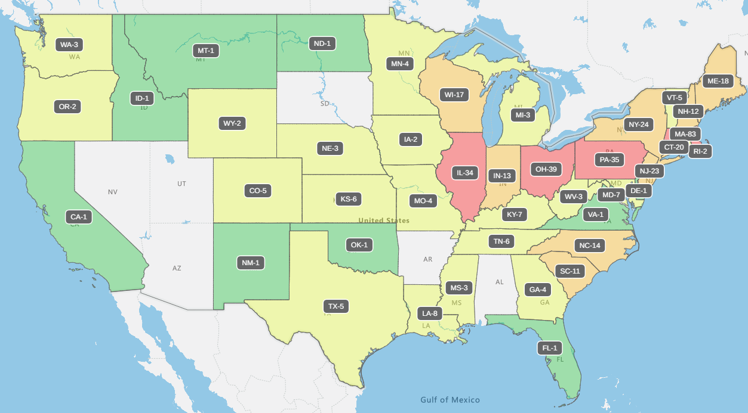
MUTUALS ACROSS THE UNITED STATES
Source: S&P Capital IQ Pro

Slide 7
PENNSYLVANIA MUTUALS VS. OTHER STATES
Numbers in parentheses represent number of mutual institutions
Source: S&P Capital IQ Pro data as of 3/31/2022

Slide 8
Time to Consider Strategic Alternatives
The Boards of Directors of mutual institutions should carefully weigh the pros and cons of each of the alternatives available to them.
  Remain Independent- and increase products and services, technology, regulatory compliance, fee income, market, etc.
  Merge with another Mutual (larger, smaller, similar size)
  Raise Capital through a Standard Conversion
  Form a Mutual Holding Company (MHC)
  Other transaction forms (Conversion Merger or CU merger)
  Increase Liquidity and Bank capital by issuing Sub Debt

Slide 9
Remain An Independent Mutual
PROS:
  Preserves Mutuality- Market differentiation
  May grow by acquiring other mutual institutions or stock banks
  Continue to serve current customers and communities
CONS:
  May not address increasing competition or technology and regulatory compliance costs facing the institution- Need to build scale
  Can only increase capital through retention of earnings which may not keep pace with expense growth
  Very difficult to achieve necessary scale to absorb additional costs of compliance and technology
  Cannot offer stock-based incentive programs to attract and motivate employees. May offer other non-stock incentive-based pay programs

Slide 10
Merge/AFILIATE with Another Mutual Institution
A mutual institution can merge directly with another mutual institution or mutual holding company (MHC). Larger partner, smaller partner, equal partner:
PROS:
  Preserves mutuality
  Build scale: the combined institution may be able to achieve greater economies of scale and become more profitable
  Merger can be structured so that disappearing mutual institution operates under its own name as a division of the combined institution
  Under an MHC structure, each institution may retain its own charter, if desired
CONS:
  May be difficult to find a mutual partner wishing to merge with you- cultural issues
  Since many mutuals are relatively small, the combined institution may continue to face many of the same challenges
  Integration of Boards and staff requires flexibility
  Depositors/Members do not receive any direct value for their interest in the institution
  Loss of a local banking institution/possible loss of jobs in the community
  ADDITIONAL INFORMATION: See Appendix-1 for additional information on planning a mutual- mutual merger and the process of a merger transaction.

Slide 11
BUSINESS COMBINATION CONSIDERATIONS FOR MUTUALS
Transactional Elements
Affiliation Considerations
Generally all accounting rules apply to mutuals just like stock companies (fair value adjustments to “acquiree”); potential exists for amortization of goodwill
Affiliation process governed by many of the same rules (informed business decision by boards, due diligence, agreements, applications, etc.)
Regulatory approval process is not demonstrably different than stock transactions
Depositor impact replaces (to a lesser extent) that of impact on shareholders
Mutuals may affiliate with other mutuals (upstream, downstream or merger of equals)
Mutuals may acquire (for cash) stock corporations (banks or stock thrifts, non-bank entities, etc.)
Mutuals may not be acquired by stock corporations (unless converted to stock, then waiting period of 3 years prior to business combination)
MHC stock institution can do a mutual merger
Source: The Kafafian Group, Inc.

Slide 12
Recent Developments regarding Mutual Bank Mergers and other Strategic Opportunities
Recent Developments in Mutual Bank Mergers:
    Mutual Bank Roll-ups
    Mutual Bank mergers with MHCs with public stockholders
    Mutual/MHC acquisition of Banks
    Mutual Bank- Conversion Merger
    Mutual Bank consolidation with a Credit Union

Slide 13
Recent Developments regarding Mutual Bank Mergers and other Strategic Opportunities
Recent Developments in Mutual Bank Mergers:
  Mutual Roll-ups;
    William Penn Bancorp (MHC) (Total assets ~ $731 mill)
      Audubon Savings Bank (NJ) (mutual) – 2017 (~ $157 mill)
      Fidelity SLA (Phila) (mutual) – 2019 (~ $87 mill)
      Washington Savings Bank (Phila) (mutual) – 2019 (~ $160 mill)
    Ambler Savings (mutual) and Bally Savings (mutual) – 2017 (~$47 mill)
    Brentwood Bank (MHC) and Union Building (mutual) – 2018 ($33 mill)
    Dollar Bank/ Dollar Mutual Bancorp (MHC) (~ $9 bill)
      Progressive Home FSLA (Pittsburgh) (mutual) – 2016 (~ $51 mill)
      Bank @tlantec (VA) (mutual) – 2016 (~$110 mill)
      Standard AVB Financial Corp - 2020- Bank acquisition. (~$1 bill)

Slide 14
Recent Developments regarding Mutual Bank Mergers and other Strategic Opportunities
Recent Developments in Mutual Bank Mergers:
  Mutual Roll-ups;
    First Federal of Lakewood (OH)/ First Mutual Holding Co. (MHC) (~$2.3 bill)
      BelPre Savings (OH) – 2016 (~$51 mill)- affiliation
      Doolin Savings (WV) -2017 (~$43 mill)- affiliation
      Warsaw Federal (OH) -2020 (~$55 mill)- affiliation
      Blue Grass Federal (KY) -2020 (~$35 mill)- affiliation
      Martinsville Savings (VA) – 2021 (~$40 mill)- affiliation

Slide 15
Recent Developments regarding Mutual Bank Mergers and other Strategic Opportunities
Recent mutual bank mergers and related issues benefiting both parties
    William Penn Bancorp Roll-up and Step 2 Conversion
      William Penn Bank increased its capital as a mutual and increased its stock conversion proceeds
      Market expansion and customer growth
      CEO of Fidelity added to Board of William Penn.
        Will be eligible for post-conversion stock benefits
    Columbia Financial (MHC) (NJ) (~ $8.1 bill) merger with RSI Bank, Roselle Bank and Freehold Bank (all NJ mutuals)
      One Roselle director added to Board of a public company

Slide 16
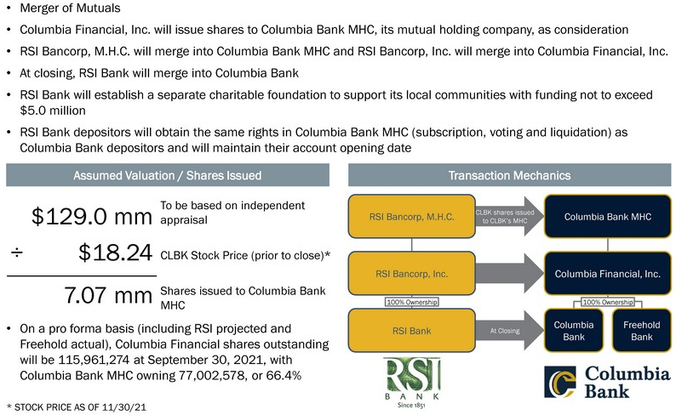
Columbia Financial, Inc. acquires RSI Bancorp, MHC
Source: Columbia Financial, Inc.’s Investor Presentation

Slide 17
Recent Developments regarding Mutual Bank Mergers and other Strategic Opportunities
Recent mutual bank mergers and related issues benefiting both parties
  Bogota Financial (MHC) (NJ) (~ 740 mill) merger with Gibraltar SB (mutual) (NJ) (~$107 mill)
    Gibraltar CEO to continue as EVP & CLO of Bogota SB
    One Board seat for a Gibraltar director
    Other Gibraltar directors added to Advisory Board, to receive advisory board fees comparable to prior Gibraltar board fees and per the Merger Agreement will receive Bogota stock benefits on par with Bogota directors

Slide 18
Recent Developments regarding Mutual Bank Mergers and other Strategic Opportunities
Recent mutual bank mergers and related issues benefiting both parties
  Mutual Bank “conversion merger” with another stock institution (typically, mutual bank with assets below $35 mill)
  Mutual Bank consolidation with a Credit Union
    A liquidation of the Mutual Bank
    Is this consistent with the mutual charter?
    Recent MS law barring CU acquisition of a Bank.
    Recent MN non-approval of CU acquisition of a Bank

Slide 19
SOME OF A CREDIT UNION’S ADVANTAGES – OVER BANKS AND MUTUALS
CASH BUYER
Cash is king (price certainty) for the selling bank; provide liquidity whereas a bank may be limited (although a cash buyer may need to secure financing)
NO REGULATORY CAPITAL DEDUCTION
While total assets increase, neither the Net Worth Ratio or Risk based Net Worth Requirement have an explicit capital deduction for goodwill (but mutuals have a regulatory deduction)
FOCUS ON THE LONG TERM
No shareholder pressure to integrate quickly; able to gain incremental earnings without extensive cost saves (and pay no taxes)
MEMBER BENEFITS
A successful transaction that enhances capital can lead to share distributions from a credit union, while still quickly accumulating capital
Source: S&P Capital IQ Pro

Slide 20
HOW WOULD (OR DID) A CREDIT UNION AND MUTUAL TRANSACTION WORK?
On April 4, 2013 Municipal Employees Credit Union of Baltimore, Inc. of Baltimore announced its intention to “acquire” Advance Mutual Savings Bank, also of Baltimore. The deal closed on December 12, 2013. Recently another credit union announced its intention to “acquire” a mutual. Total process took approximately eight months. How would this type of transaction work and are these the next wave of alternate transactions involving mutuals?
Advance Mutual was subject to a written agreement with the OCC (this was not an FDIC assisted transaction)
MECU entered into a P&A Agreement concurrent with Advance Mutual’s Plan of Voluntary Dissolution
MECU acquired all customer relationships and assumed deposits (creating a tiny core deposit intangible)
Transaction closes with distribution of $6.6 million of net assets to depositors of Advance Mutual (had $5.8 million of capital at announce)
Source: S&P Capital IQ Pro

Slide 21
ACQUISITION COMPETITION
Source: S&P Capital IQ Pro

Slide 22
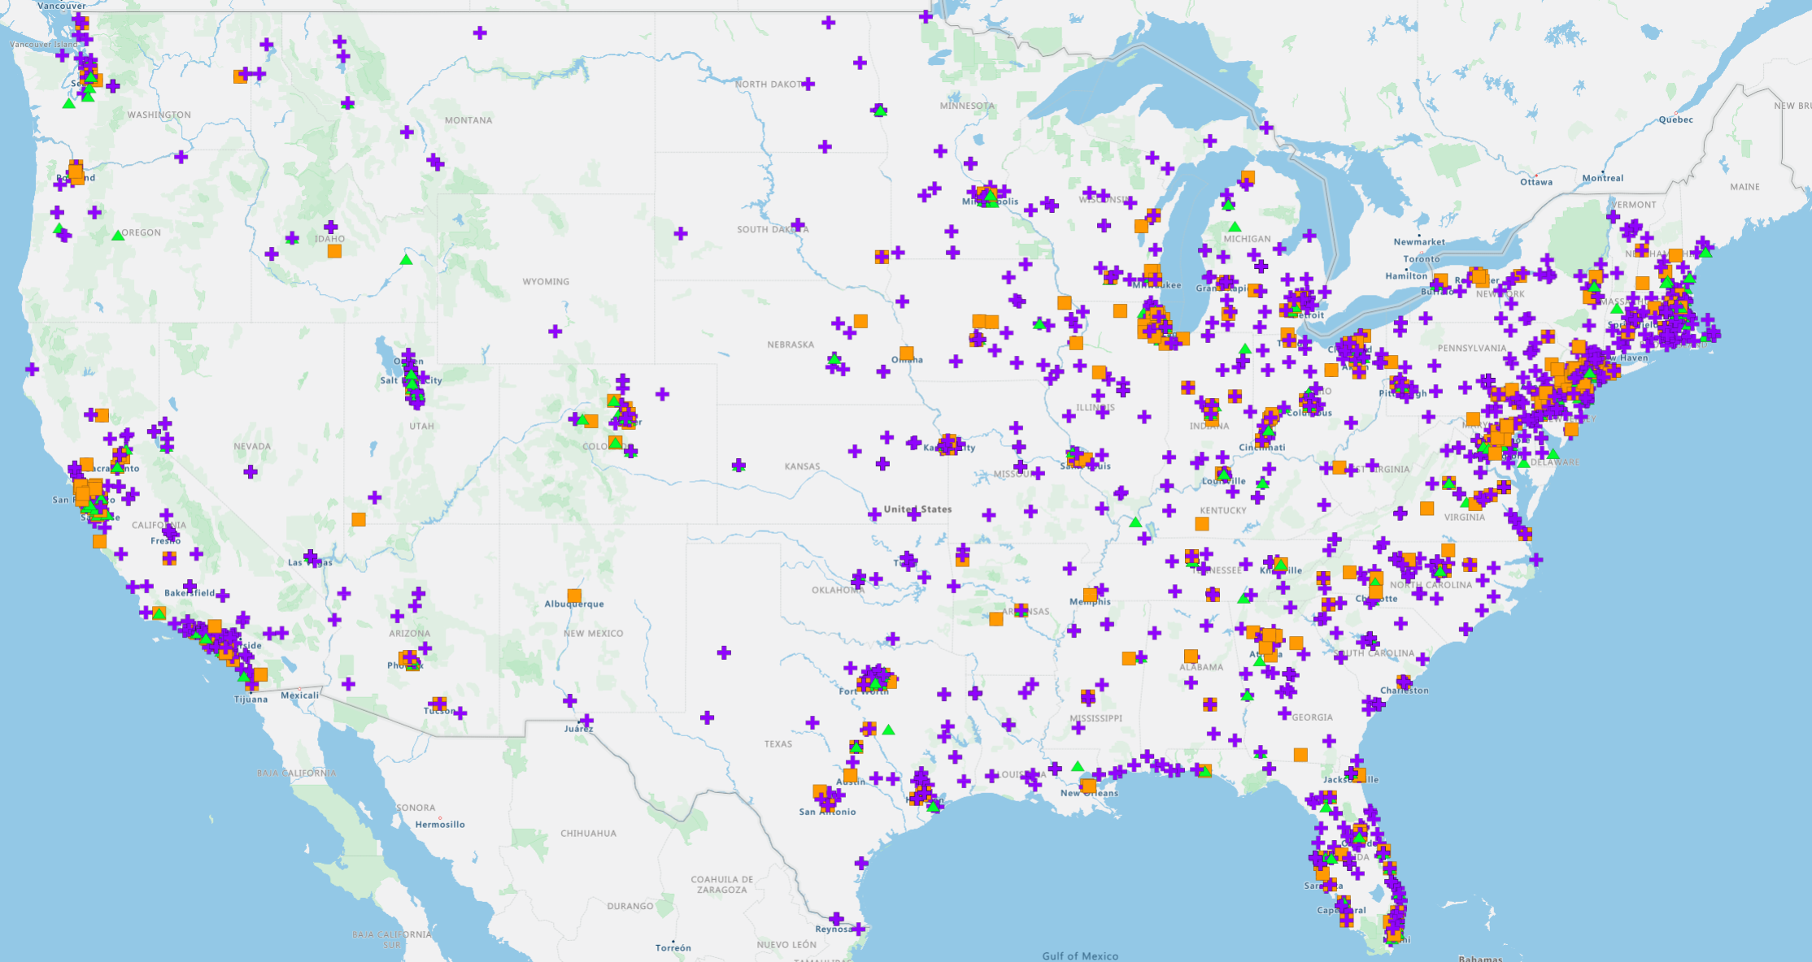
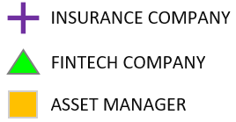
NON-BANK ACQUISITIONS
MID-ATLANTIC REGION
STATE | # OF DEALS
PENNSYLVANIA | 169
DELAWARE | 15
MARYLAND | 78
NEW JERSEY | 129
NEW YORK | 291
WASHINGTON, DC | 6
TRANSACTION STATS
YEAR | # OF DEALS
2019 | 1,041 | 689 | 160 | 192
2020 | 1,076 | 743 | 164 | 169
2021 | 1,481 | 970 | 225 | 286
YTD 2022 | 258 | 126 | 50 | 82
TOTAL | 3,856 | 2,528 | 599 | 729
Source: The Kafafian Group, Inc. review of Company reports and S&P Global IQ Pro data, deals announced from January 1, 2019 to May 5, 2022

Slide 23
Recent Developments regarding Mutual Bank Mergers and other Strategic Opportunities
Opportunities available to Mutuals to raise additional capital:
    Standard Conversion
    MHC Formation and Minority Stock Issuance
    Issuance of Sub Debt securities

Slide 24
Standard Conversion
A standard conversion to stock form remains an option for many mutual institutions.
PROS:
  No change in management or job losses
  Depositors and management have opportunity to become stockholders and potentially reap direct benefits of future growth and stock price appreciation
  Increase in bank capital allows future growth for greater profitability
  Management and Board can implement stock-based benefit programs
  Stock institution can combine with other types of institution without unreasonable regulatory burden
CONS:
  Time and expense and management effort to prepare applications
  Loss of mutuality
  Future accountability and reporting to stockholders/owners
  Additional burden and expense of operating as a public company

Slide 25
Mutual Holding Company Formation
A mutual holding company (MHC) reorganization remains an option for all mutual institutions and can take several forms: two-tiered MHC or three-tiered MHC, in either case with or without stock issuance.
PROS:
  Preserves Mutuality
  Board of Directors and depositors maintain complete control over the institution
  More flexibility in acquisitions of other financial institutions in the MHC structure. May hold other institutions under a separate charter.
  A no-stock MHC reorganization does not require any sale of stock to the public
  May raise capital incrementally as needed or not at all
  Limited or no interference from minority stockholders
  Management and Board can implement stock benefit plans
  May issue Sub Debt to aid in liquidity and increase Bank Tier 1 capital
CONS:
  Generally, less trading liquidity in any MHC public stock sold than a full conversion
  Dividend limitations without dividend waiver approval with member vote
  Limitations on future stock benefit plans due to reduced size of stock offering

Slide 26
Recent Developments regarding Mutual Bank Mergers and other Strategic Opportunities
Increasing Bank capital and liquidity with issuance of Sub Debt

Slide 27
FLEXIBILITY IN STRUCTURE = FLEXIBILITY IN TERMS OF OPERATIONS AND ACCESS TO CAPITAL
Pros | Cons
Temporary flexibility (though need to pay both principal and interest) | If not structured properly, may not receive regulatory capital credit at the parent or intermediate parent level
Tax benefit on interest payments | If not structured property, may create a disparity in Consolidated vs. Bank capital adequacy measures
Potential to directly measure return on capital deployed (and asks the question: are there other uses of the proceeds from the line of credit?) | May require permission from regulators to return cash from bank to parent to make payments
Helps reinforce pricing discipline (do not have a “blank check” to make acquisitions) | Reduces internal capital generation ratio during payment periods (would need to pay back more than what is borrowed)
Local Bancshares MHC
Sub debt opportunity*
Local Bancshares Inc
Downstreamed as common equity to bank (permanent capital)
Local Community Bank **
Double leverage ratio = bank level equity capital / midtier level equity capital; regulatory guidance generally presumes a comfort level of 120% or less.
** Additional subsidiaries could exist of the Bank or of the Mid-tier.
Source: The Kafafian Group, Inc.

Slide 28
Increasing Bank capital and liquidity with issuance of Sub Debt
Recent Sub Debt Transactions by MHCs
    First Mutual Holding Co. (OH) - Multiple sub debt offerings
      $15 mill in 2020; $10 mill in 2018
    Manasquan Bank/ MB Financial (NJ) - $30 million in 2021
Recent Sub Debt Transactions by MHCs
    Typical buyers of sub debt are other banks and insurance companies
    Debt is “interest only” for 10 years; Callable after 5 years
    Interest rate is fixed for 5 years, then floating to maturity
    Issued by MHC mid-tier or MHC; Tier 1 capital at Bank (if proceeds down streamed)
    Provides Bank liquidity
    See Appendix-2 for additional information on Sub Debt transactions

Slide 29
APPENDIX-1: Merger with Another Mutual Institution
A mutual institution can merge directly with another mutual institution or mutual holding company.
Larger partner, smaller partner, equal partner:

Slide 30
APPENDIX-1:
ISSUES IN A MUTUAL – MUTUAL MERGER
Regulatory Profile: Does your regulator have confidence that the combined organization will be stronger than the two separate mutuals?
Board composition: Size, engagement, community representation
Advisory Board
Management Structure and Succession Planning
Staff Retention and Efficiencies
Evaluate Branch Network Footprint and Efficiencies
Potential Vendor Cost Savings
Potential Expanded Products and Services through Expanded Network
Staff Retention Bonuses and Severance Pay Plans

Slide 31
APPENDIX-1:
ISSUES IN A MUTUAL – MUTUAL MERGER
Honor Existing Management Contracts and SERPs
Honor Director Retirement Plan
Integration of Employee Benefit Plans: Potential Cost Savings
Treatment of Depositors (parity)
Maintain Identity of Both Institutions (either as a division or a separate charter)
Indemnification and Insurance (maintain D&O indemnification and “tail insurance.”)
Commitment to Communities Served (continuity of community charitable contribution funding)

Slide 32
APPENDIX-1:
MUTUAL MERGERS: THE PROCESS
Consider a Short-List of Potential Mutual Partners
Identify Key Priorities
Determine Channels of Communication: Who will speak for you?
Execute Non-Disclosure/Confidentiality Agreement
Preliminary Discussions
Establish Transaction Term Sheet/Letter of Interest
Substantive Due Diligence
Draft Definitive Merger Agreement
Board Approvals
Public Announcements
Regulatory Applications and Approvals
Transition Planning and customer communications
Implementation/Merger Closing

Slide 33
APPENDIX-2:
Alternative Source of Capital – Subordinated Debt
Typical Terms for Subordinated Debt Offering:
Unsecured
Interest rate can be fixed or floating; Typically, 5 years fixed, then floating.
Minimum maturity of five years; Typically, term of 10 years
Principal cannot be accelerated upon event of default, with limited exceptions
Holder does not have the right to require redemption prior to maturity
Issuer cannot redeem within first five years with certain limited exceptions
No financial covenants

Slide 34
APPENDIX-2:
Alternative Source of Capital – Subordinated Debt
Subordinated Debt vs. Holding Company Loan
Sub Debt is unsecured whereas holding company loan typically secured by stock of subsidiary bank
Sub Debt has no financial covenants whereas holding company loan generally has a number of financial covenants (e.g., minimum capital ratios, maximum problem asset ratios, etc.)
Sub Debt does not allow for acceleration of principal upon default (with certain limited exceptions), whereas holding company loan permits acceleration of principal upon event of default
Sub Debt is eligible as Tier 2 capital at holding company, whereas holding company loan is not eligible as Tier 2 capital – both can be down-streamed to bank as Tier 1 capital

Slide 35
APPENDIX-2:
Alternative Source of Capital – Subordinated Debt
Subordinated Debt vs. Holding Company Loan
Interest rate on holding company loan is typically lower than interest rate on Sub Debt
Holding company loan has no restrictions as to prepayment, whereas Sub Debt cannot be repaid during first five years
Holding company loan can typically be arranged and closed faster than Sub Debt
Sub Debt usually purchased by multiple banks, insurance companies and private equity funds whereas holding company loan is with one lender
Sub Debt usually placed by investment banker and subject to placement agent fee and legal fees

Slide 36
QUESTIONS?
Richard (Ricky) Fisch, Esq.
Jones Walker LLP
499 S Capitol St, SW #600
Washington, DC 20003
202-434-4665
RFisch@joneswalker.com
Rich Trauger
The Kafafian Group, Inc.
90 Highland Avenue, Suite 201
Bethlehem, PA 18017
973-299-0300 ext 113 rtrauger@kafafiangroup.com

