Slide 1
Pay Now or . . .
Pay a LOT More For It Later
Wage and Hour Issues in the Workplace
John R. Martin
Lindsey E. Snavely
jmartin@pillaraught.com
lsnavely@pillaraught.com

Slide 2
DOL Wage And Hour Division

Slide 3
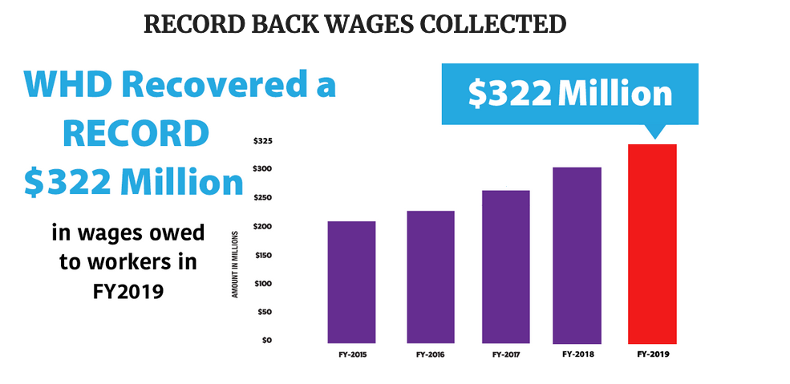
Some (Scary) Statistics

Slide 4
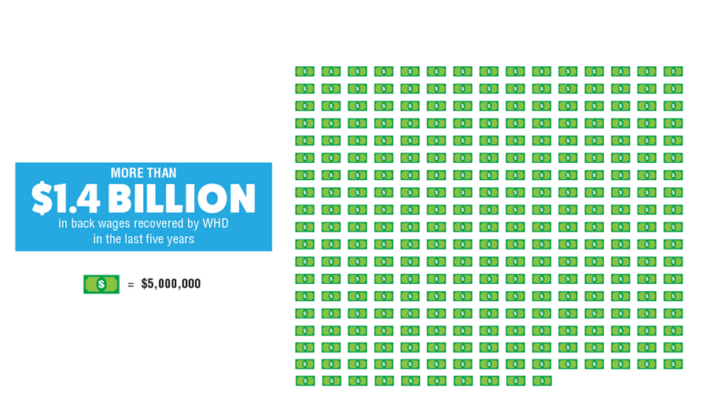
Some (Scary) Statistics

Slide 5
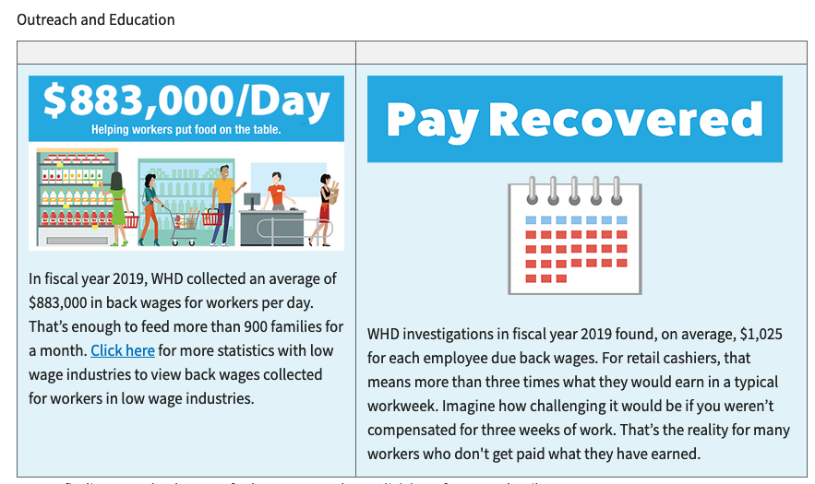
Some (Scary) Statistics

Slide 6
The Plaintiff’s Bar

Slide 7
Some More (Scary) Statistics
6,716 FLSA cases filed between June 2019-June 2020.
Top 3 Settlements in 2020:
$100 million (failure to provide meal and rest breaks)
$100 million (misclassified as independent contractors)
$98.8 million (training program violations)

Slide 8
This Will Never Happen To My Bank….OH MY!

Slide 9
Why Are These So Expensive
Class/Collective Actions (Lots of plaintiffs)
Back Pay (2, maybe 3, years)
Liquidated Damages (2x back pay)
Attorneys’ Fees (Think seven figures)
Operational Pains (Depositions and documents)
Reputational Pains (#socialmediawhat?!)

Slide 11
The Exempt Worker
Every employee must be paid minimum wage unless clearly exempt under federal/state regulations.
”White-collar” exemptions (in PA):
Administrative
Executive
Professional
Outside sales
Highly-compensated

Slide 12
Where The Employer Goes Wrong
“She is the Manager of Operations.”
“He is paid a salary.”
“These are professionals.”
“Everyone else does it.”
“She makes $150,000.”
”He doesn’t want to punch a clock.”

Slide 13
Administrative Exemption Gone Wrong
Directly related to management or general business operations.
Tax, finance, accounting, budgeting, auditing, insurance, quality control, purchasing, procurement, advertising, marketing, research, safety and health, personnel management, human resources, employee benefits, labor relations, public relations, government relations, computer network, Internet and database administration, legal and regulatory compliance, and similar activities.
As opposed to working on a manufacturing line or selling a product in a retail or service establishment.

Slide 14
Administrative Exemption Gone Wrong (Continued)
What is “Discretion and Independent Judgment”?
What are “Matters of Significance?”
The Watch-Out Positions
Mortgage Loan Originators
Real Estate Evaluators and Appraisal Review Officers

Slide 15
Working Off The Clock
Working anytime, anywhere.
Non-exempt employees must be paid for all “time worked,” which means any time “suffered or permitted” by the employer.

Slide 16
Where The Employer Goes Wrong
Working during breaks, outside the workplace.
Rogue supervisors.
Tracking hours worked.
Travel time and trainings.
Rounding.

Slide 17
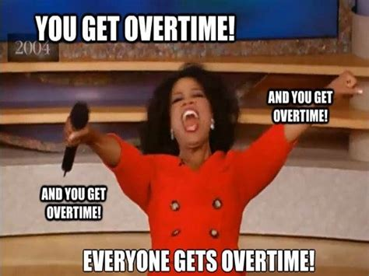
The Overtime Dilemma
It’s This Simple in PA:
All hours worked over forty (40) in a workweek must be paid at time-and-a-half.

Slide 18
Where The Employer Goes Wrong
The fluctuating workweek methodology.
Permissible under federal law.
Not permissible under PA law.
Pay no matter what (then discipline).
It’s 40 hours over one workweek, not 80 hours over two.
Comp time.
And again . . . rogue supervisors.

Slide 19
Paychecks and Deductions
Wages earned in a pay period must be made within a certain period of time.
Whenever an employee leaves the employer, voluntarily or involuntarily, compensation earned is due by the next regular pay day.
Only deductions made for the convenience of the employee are permissible.
Allowable deductions for exempt employees and non-employees are different.

Slide 20
Where The Employer Goes Wrong
Holding pay following separation.
Impermissible deductions.
Overpayments.
Weather issues.
Repayments for theft and/or damages.
Bringing pay down below minimum wage.

Slide 21
Pay Equity
Area of priority for EEOC’s Strategic Enforcement Plan since 2012.
“Equal pay for equal work.”
Salary history bans – coming to a place near you!
New Jersey – all employers.
Pennsylvania – state agencies.
Philadelphia – employs 1 or more persons.
Pittsburgh – city agencies and offices.
Maryland – all employers.

Slide 22
Employer Best Practices
Perform internal wage and hour audits.
Train your employees and your supervisors on wage and hour policies and procedures.
Follow good recordkeeping practices –at least 3 years.
Remember state laws –not just federal.
Review/update wage and hour policies –include the safe harbor language.
Review/update job descriptions (oh, and have them if you don’t!).

Slide 23
Thank you for your time!
4201 E. Park Circle
Harrisburg, PA 17111
(717) 308-9910
www.pillaraught.com

